Slide 1
Story Structure: How to Plot Your Story Roadmap
Erin Riha

Slide 2
What is story structure?
The order in which elements of a narrative are presented to the reader
Comprised of two parts
Plot: the chain of events in the story
Elements: protagonists, conflicts, settings, theme, etc. that motivate the narrative action

Slide 3
Why is story structure important?
Good story structure establishes a pattern of problem-solving
Good story structure helps determine the order of events in your story based on reader expectations
When your story “isn’t working” it’s often because the story structure is broken

Slide 4
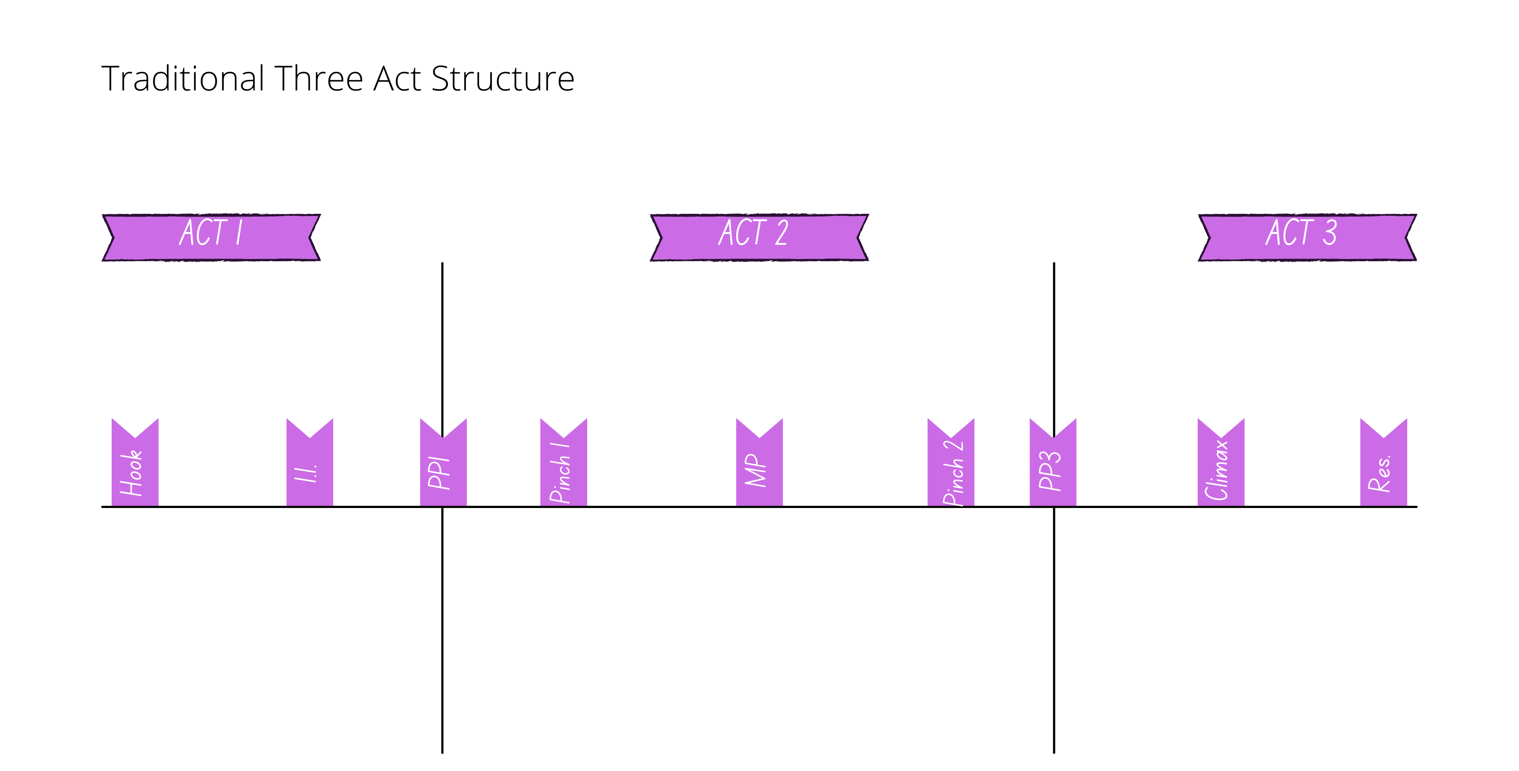
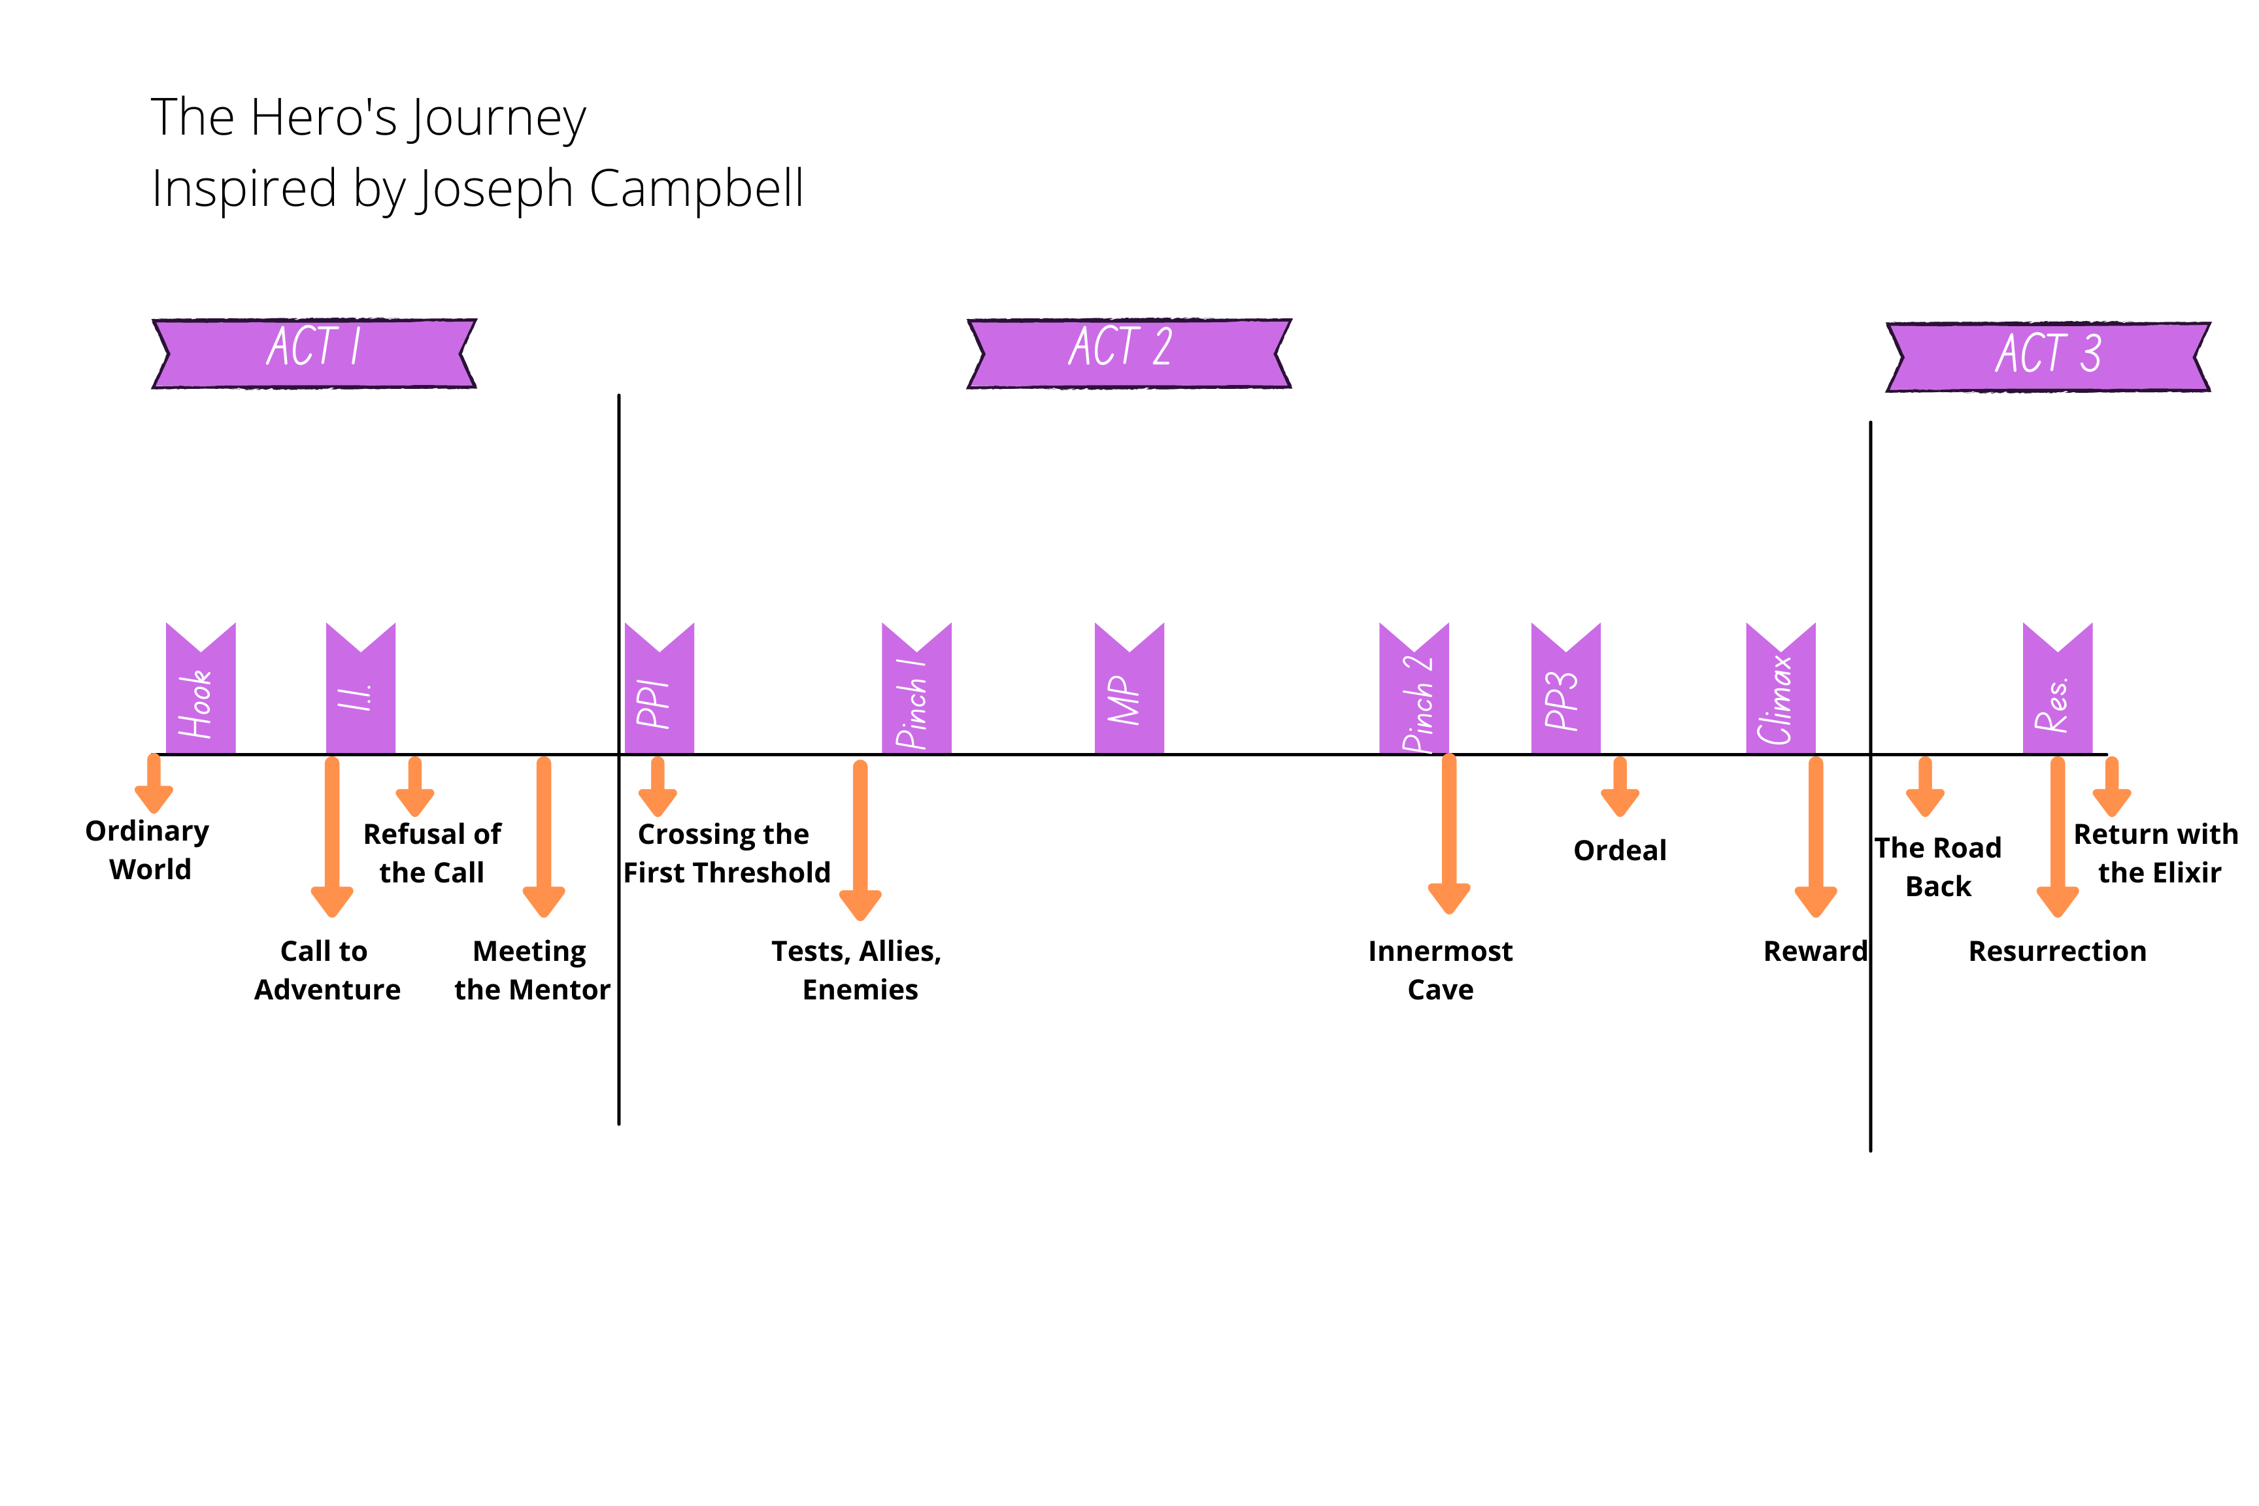
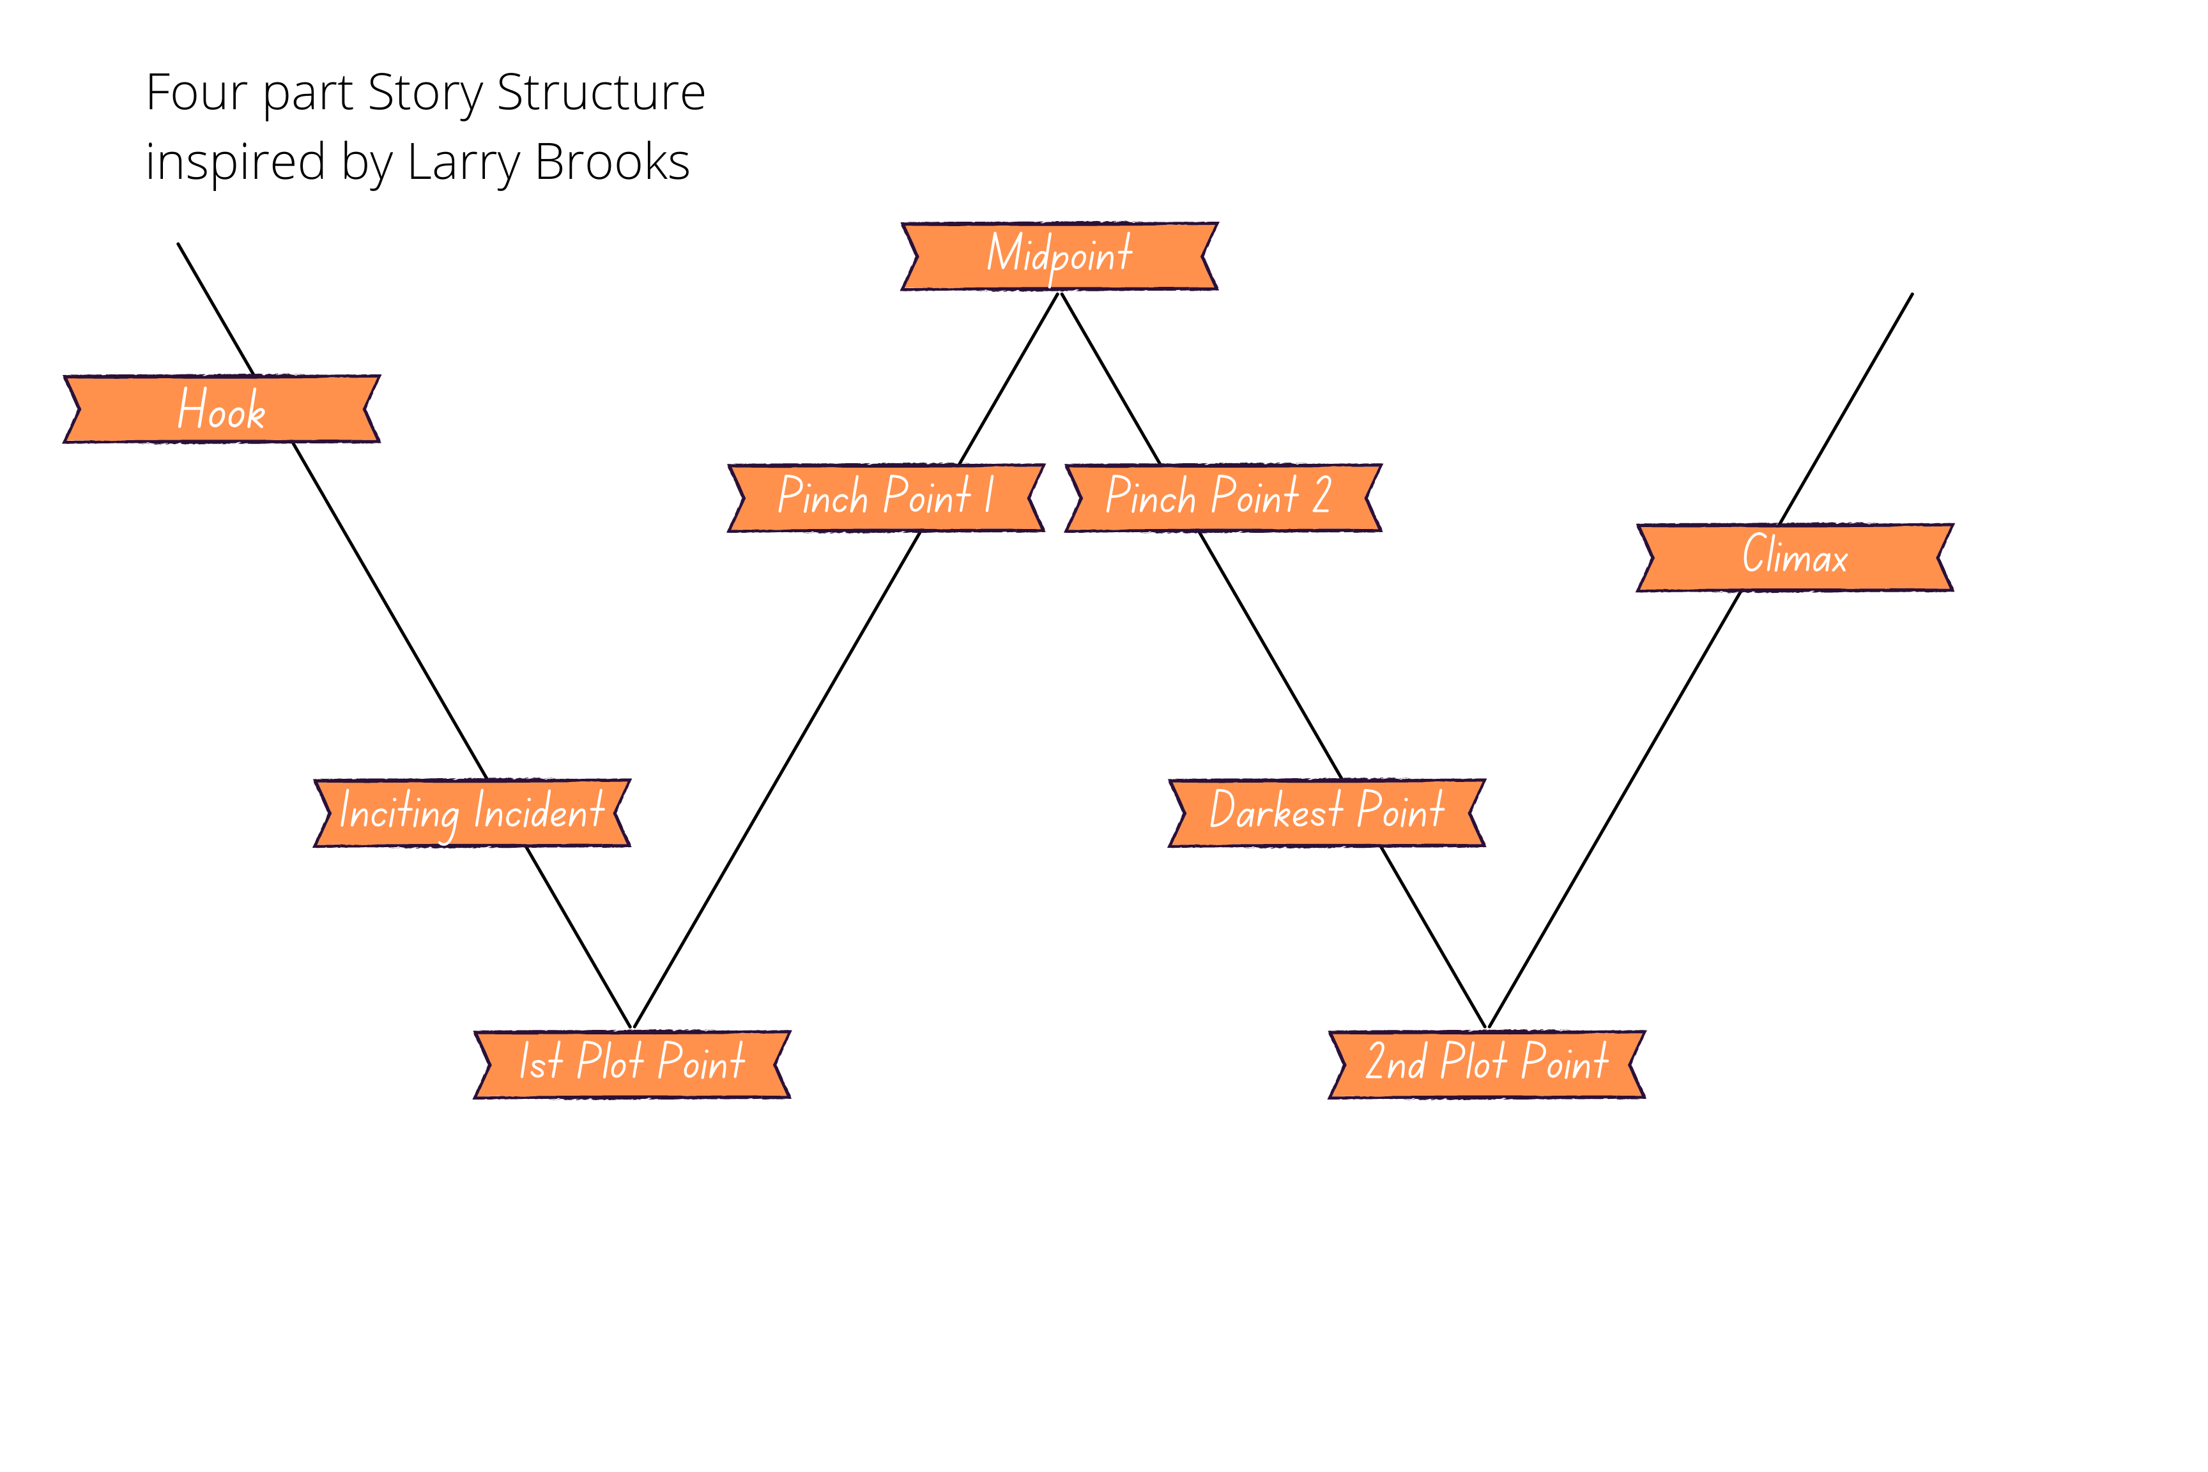
Frameworks for Good Story Structure
Notes:
Many options for story structure:
3 act
The Hero’s Journey
4 part
Save the Cat (not pictured)
What do they all have in common? Plot points

Slide 5
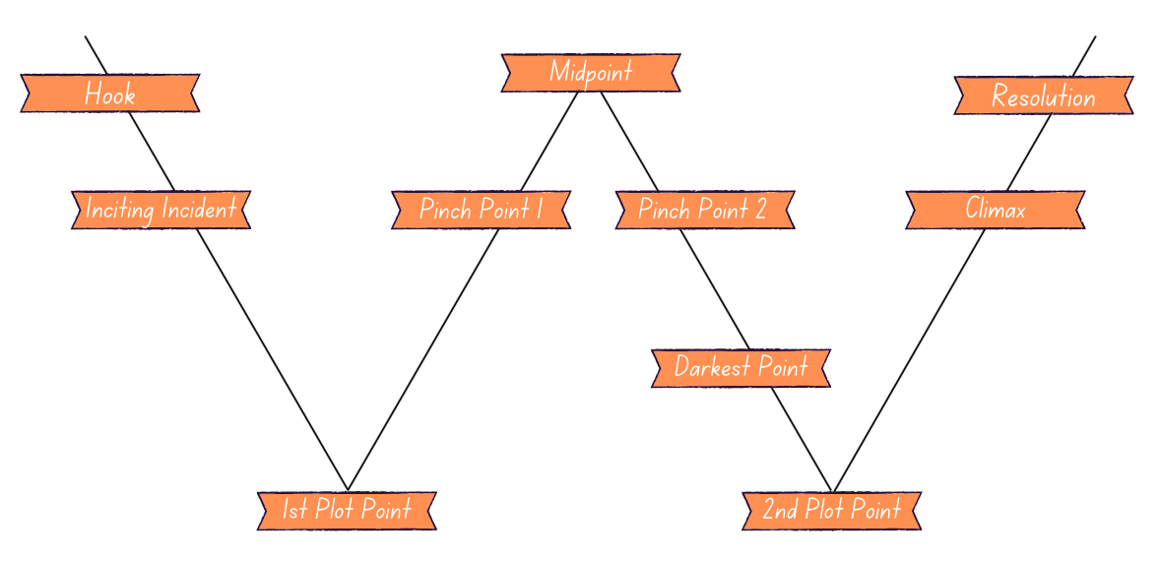
Frameworks for Good Story Structure
Notes:
This is my favorite framework, so this is what I’ll be using

Slide 6
What are the major Plot Points?
Hook → the first thing that makes you go “hmmm?”
Inciting Incident → the thing that propels the hero into the action of the main story
First Plot Point → when the hero makes a decision to cross the threshold
First Pinch Point → the antagonistic force applies pressure to the hero
Notes:
Let’s first define each of the major plot points, and then we’ll talk through an example

Slide 7
What are the Plot Points? (cont’d.)
Midpoint → shifts the context of the story and moves hero from “reaction” to “action”
Pinch Point 2 → presence of the antagonistic force that sets up the lowest point
Third Plot Point → the beginning of the end
Climax → the conclusion of the A plot
Resolution → tying up loose ends, establishing the new normal

Slide 8
Hook
Hook: The first “thing” that happens to your MC
Example:
A League of Their Own: Dottie is happy, but Kit wants to try out for the new women’s baseball league
The Lion King: There’s a new lion cub in the circle of life
Questions to ask:
Does your Hook establish your MC’s “Normal World”?
Does your Hook represent the ending of an old way of life?
Notes:
Normal vs. New: The School for Good and Evil by Soman Chainani– Normal is a world where Agatha lives next to a cemetery and everyone assumes she’s evil, and Sophie is the golden girl and everyone assumes she’s meant to be a princess; the New world is one in which it’s actually the reverse, but they’re back in their home village, learning to embrace their new roles, working together to find balance
Character beginning vs. Character end: Shadow & Bone: Alina begins wanting to hide away with Mal; She ends being in hiding with Mal, but this time they’re running from the Darkling
Ending vs. Beginning: The Sandlot: This book starts with Smalls leaving behind a life of indoor fun with erector sets as he moves to L.A., and ends with him beginning a new life with his friends, playing baseball until they all eventually move away

Slide 9
Inciting Incident
Inciting Incident: The call to action
The first time the hero is asked to engage with the main conflict
Examples:
A League of Their Own: Dottie agrees to join the team only to help her sister, Kit
The Lion King: Simba goes to the Elephant Graveyard and is cornered by hyenas

Slide 10
Inciting Incident
Questions to ask:
Does your inciting incident signal the first glimpse of the antagonistic force?
Does your inciting incident serve as a question for the plot to answer?
Do your inciting incident signal the beginning of the main conflict?
Notes:
Bookends: in SHADOW & BONE, II= Alina Starkov and Mal are attacked by Volcra as they pass through the Fold; Climax = as the Darkling harnesses Alina’s newfound power to use the Volcra to kill his own people, Alina finds her inner strength to fight back and escapes from him with Mal
Q&A: Any mystery novel asks Whodunit? Romances ask will they or won’t they? When Harry Met Sally: Can men and women ever just be friends? In this case, no.
Beginning & End: In THE LITTLE RASCALS, II=Alfalfa accidentally burns down the clubhouse because he was hosting a romantical date with a GIRL, and Climax= the boys win the race money and can rebuild their clubhouse because a GIRL saved them

Slide 11
Plot Point 1
PP1: The point of no return
The MC makes an active choice in response to the inciting incident that propels them into the A plot of the story
Examples:
A League of Their Own: When Jimmy Dugan is useless, Dottie steps up and acts as the manager
The Lion King: After he kills Mufasa, Scar tells Simba he is to blame and tells him to run away and never return

Slide 12
Plot Point 1
Questions to ask:
Does your PP1 create a door of no return that the MC chooses to go through?
Does your PP1 represent a symbolic death of an old “life,” and a symbolic rebirth of a new life?
Does your PP1 represent your MC going after the lie they believe?
In the alternative: MC chasing their want?
Notes:
Doors of no return: The Wizard of Oz– PP1: Dorothy enters Oz, PP3: Dorothy enters the Wicked Witch of the West’s tower
Death & Rebirth: The Lion King: PP1: Following Mufasa’s death, Simba flees and lets his family think he died in a stampede; PP3: Simba returns to the Pridelands to avenge his father’s death, now a fully grown male lion, and his family thinks he’s returned from the dead
Lie vs. Truth:
Want vs. Need: Just about any romcom

Slide 13
Pinch Point 1
Your first pinch point set up the Midpoint
Pinch Points turn the plot in a way that emphasizes the antagonistic force’s ability to create obstacles
The MC will always interact with the antagonistic force in this pivotal scene.
Examples:
A League of Their Own: Dottie’s leadership inspires Jimmy Dugan to stand up and manage in his own right
The Lion King: Scar takes over, laying waste to the Pridelands

Slide 14
Pinch Point 1
Questions to ask:
Do your 1st pinch point set up plot or thematic clues?
Do your 1st pinch point foreshadow the Midpoint?
Do your 1st pinch point emphasize the stakes?
Do your 1st pinch point check in on the antagonistic force?
Notes:
Clues: Inside out—Justice for Bing Bong
Foreshadow: The Little Rascals: Pinch 1—Alfalfa’s love/hate letter goes over poorly with Darla, foreshadowing Alfalfa’s need to abandon his task of watching the Blur to rectify things with her. Pinch 2– Alfalfa is distracted by his disastrous singing performance to Darla and the Blur is stolen, which foreshadows a blow up between Alfalfa and Spanky
Stakes:
Antagonist:

Slide 15
Midpoint
The midpoint is the fulcrum on which the context of your story changes
Triggers the external shift from ‘reaction’ to ‘action’
Examples:
A League of Their Own: When the league is faltering, Dottie does the splits to encourage attendance
The Lion King: While living the Hakuna Matata life, Simba sees a vision of Mufasa telling him to “remember who you are”
Notes:
Major revelation: Phantom of the Opera (musical): Midpoint: Christine and Da’ae fall in love and the Phantom is PISSSED
Moment of truth: Little Women– Midpoint: Meg and Mr. Brooks announce their engagement. Jo realizes in a moment of truth that everything must change.
Reaction to action: Groundhog day: After spending too many days to count just messing around, Phil realizes he can actually use the repetitive days to get to know Rita and form a real connection with her

Slide 16
Midpoint
Questions to ask:
Does your midpoint include a major revelation that shifts the plot?
Does your midpoint set up a moment of truth?
How does your midpoint change your MC’s focus from reacting to acting?
Notes:
Major revelation: Phantom of the Opera (musical): Midpoint: Christine and Da’ae fall in love and the Phantom is PISSSED
Moment of truth: Little Women– Midpoint: Meg and Mr. Brooks announce their engagement. Jo realizes in a moment of truth that everything must change.
Reaction to action: Groundhog day: After spending too many days to count just messing around, Phil realizes he can actually use the repetitive days to get to know Rita and form a real connection with her

Slide 17
Pinch Point 2
Pinch Point #2 sets up the action in PP3 (and the all is lost moment before that)
Pinch Point #2 emphasizes the antagonistic force’s ability to create obstacles and alter the plot
The MC will always interact with the antagonistic force in this scene.
Examples:
A League of Their Own: When asked, Dottie tells Jimmy that Kit is done pitching the game, treating Kit as an adult for the first time
The Lion King: Simba is devastated to see the ruin of the Pridelands in his absence

Slide 18
Pinch Point 2
Questions to ask:
Does your 2nd pinch point set up plot or thematic clues?
Does your 2nd pinch point foreshadow the PP3 (and darkest moment) to come?
Does your 2nd pinch point emphasize the stakes?
Does your 2nd pinch point check in on the antagonistic force?
Notes:
Clues: Inside out—Justice for Bing Bong
Foreshadow: The Little Rascals: Pinch 1—Alfalfa’s love/hate letter goes over poorly with Darla, foreshadowing Alfalfa’s need to abandon his task of watching the Blur to rectify things with her. Pinch 2– Alfalfa is distracted by his disastrous singing performance to Darla and the Blur is stolen, which foreshadows a blow up between Alfalfa and Spanky
Stakes:
Antagonist:

Slide 19
Plot Point 3
PP3: The beginning of the end
The last new information, characters
The MC passes through another door of no return, propelling them into the final conflict of the story
Examples:
A League of Their Own: Kit transfers to a different team to get out of Dottie’s shadow and Dottie demands Kit act like an adult and take responsibility
The Lion King: Scar confesses that HE killed Mufasa
Notes:
Meanwhile, Dottie’s husband (played by Bill Pullman) arrives on leave and she decides to go home before the World Series to return to her life as a wife and raise a family

Slide 20
Plot Point 3
Questions to ask:
Does your PP3 create a door of no return that the MC chooses to go through?
Does your PP3 represent a symbolic death of an old “life,” and a symbolic rebirth of a new life?
Does your PP3 represent your MC going after the truth they’ve learned?
In the alternative: MC chasing their need?
Notes:
Doors of no return: The Wizard of Oz– PP1: Dorothy enters Oz, PP3: Dorothy enters the Wicked Witch of the West’s tower
Death & Rebirth: The Lion King: PP1: Following Mufasa’s death, Simba flees and lets his family think he died in a stampede; PP3: Simba returns to the Pridelands to avenge his father’s death, now a fully grown male lion, and his family thinks he’s returned from the dead
Lie vs. Truth:
Want vs. Need: Just about any romcom

Slide 21
Climax
Climax: The final interaction that leads to the resolution of the main conflict
Examples:
A League of Their Own: Dottie returns to play Kit’s team halfway through the World Series and Kit beats her in her own right
The Lion King: Simba defeats Scar and regains control of the Pridelands, as his father always wanted for him

Slide 22
Climax
Questions to ask:
Does your climax signal the final look/defeat of the antagonistic force?
Does your climax serve as the answer to the question first posed during the inciting incident?
Does your climax signal the end of the main conflict?
Notes:
Bookends: in SHADOW & BONE, II= Alina Starkov and Mal are attacked by Volcra as they pass through the Fold; Climax = as the Darkling harnesses Alina’s newfound power to use the Volcra to kill his own people, Alina finds her inner strength to fight back and escapes from him with Mal
Q&A: Any mystery novel asks Whodunit? Romances ask will they or won’t they? When Harry Met Sally: Can men and women ever just be friends? In this case, no.
Beginning & End: In THE LITTLE RASCALS, II=Alfalfa accidentally burns down the clubhouse because he was hosting a romantical date with a GIRL, and Climax= the boys win the race money and can rebuild their clubhouse because a GIRL saved them

Slide 23
Resolution
Resolution: final scenes, ties off loose ends
Examples:
A League of Their Own: The Women’s league is a success in the wake of a sold out World Series
The Lion King: The circle of life continues as Simba and Nala welcome their new lion cub to the Pridelands
Notes:
Normal vs. New: The School for Good and Evil by Soman Chainani– Normal is a world where Agatha lives next to a cemetery and everyone assumes she’s evil, and Sophie is the golden girl and everyone assumes she’s meant to be a princess; the New world is one in which it’s actually the reverse, but they’re back in their home village, learning to embrace their new roles, working together to find balance
Character beginning vs. Character end: Shadow & Bone: Alina begins wanting to hide away with Mal; She ends being in hiding with Mal, but this time they’re running from the Darkling
Ending vs. Beginning: The Sandlot: This book starts with Smalls leaving behind a life of indoor fun with erector sets as he moves to L.A., and ends with him beginning a new life with his friends, playing baseball until they all eventually move away

Slide 24
Resolution
Questions to ask:
Has your Resolution established your MC’s “New World”? (Compared to the old world?)
Does your Resolution show how your MC has evolved from an ”old normal” version of themselves, to a “new normal” version?
Does your resolution represent a new beginning?
Notes:
Normal vs. New: The School for Good and Evil by Soman Chainani– Normal is a world where Agatha lives next to a cemetery and everyone assumes she’s evil, and Sophie is the golden girl and everyone assumes she’s meant to be a princess; the New world is one in which it’s actually the reverse, but they’re back in their home village, learning to embrace their new roles, working together to find balance
Character beginning vs. Character end: Shadow & Bone: Alina begins wanting to hide away with Mal; She ends being in hiding with Mal, but this time they’re running from the Darkling
Ending vs. Beginning: The Sandlot: This book starts with Smalls leaving behind a life of indoor fun with erector sets as he moves to L.A., and ends with him beginning a new life with his friends, playing baseball until they all eventually move away

Slide 25
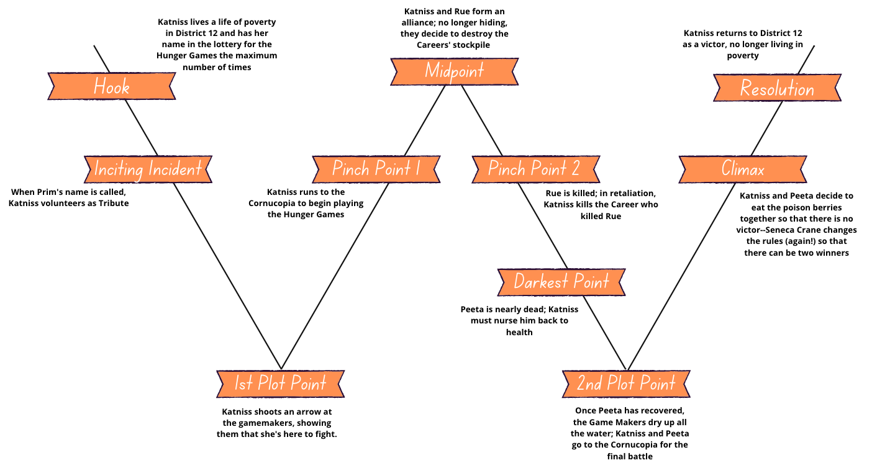
Frameworks for Good Story Structure
The Hunger Games
By Suzanne Collins
Notes:
Let’s talk through what each of these major plot points looks like in Suzanne Collins’s THE HUNGER GAMES

Slide 26
Putting it all together
If something seems broken, look at your plot points
Plot Points are not monoliths
Map out just your plot points and ask, “Can I tell my story using just these?”
When in doubt, look at other examples of great storytelling

Slide 27
Putting it all together
Notes:
Pass out worksheet with W on it
Encourage them to think about their projects

Slide 28
Resources
K.M. Weiland website: helpingwritersbecomeauthors.com
Save the Cat Writes a Novel, Jessica Brody
Story Engineering, Larry Brooks
The Hero’s Journey, Joseph Campbell
Reedsy Blog, Seven Narrative Structures every Writer Should Know: blog.reedsy.com/guide/story-structure/#2__the_hero_s_journey

