Slide 1
How to Move Through
Writer’s Block and Finish That First Draft Dump!
with Author Sonja Thomas
2022 Willamette Writers Conference

Slide 2
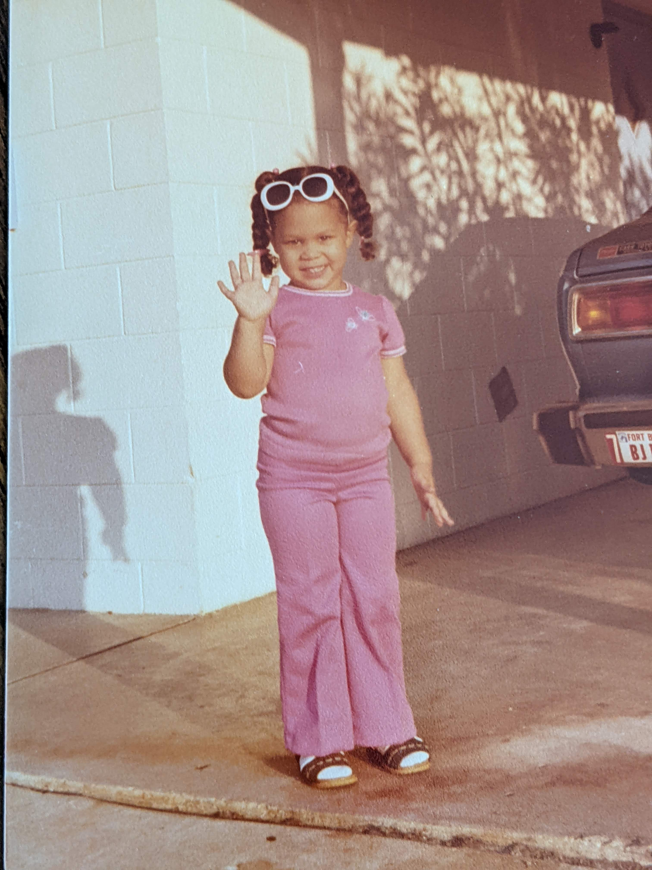
Hello! I’m Sonja Thomas.

Slide 3
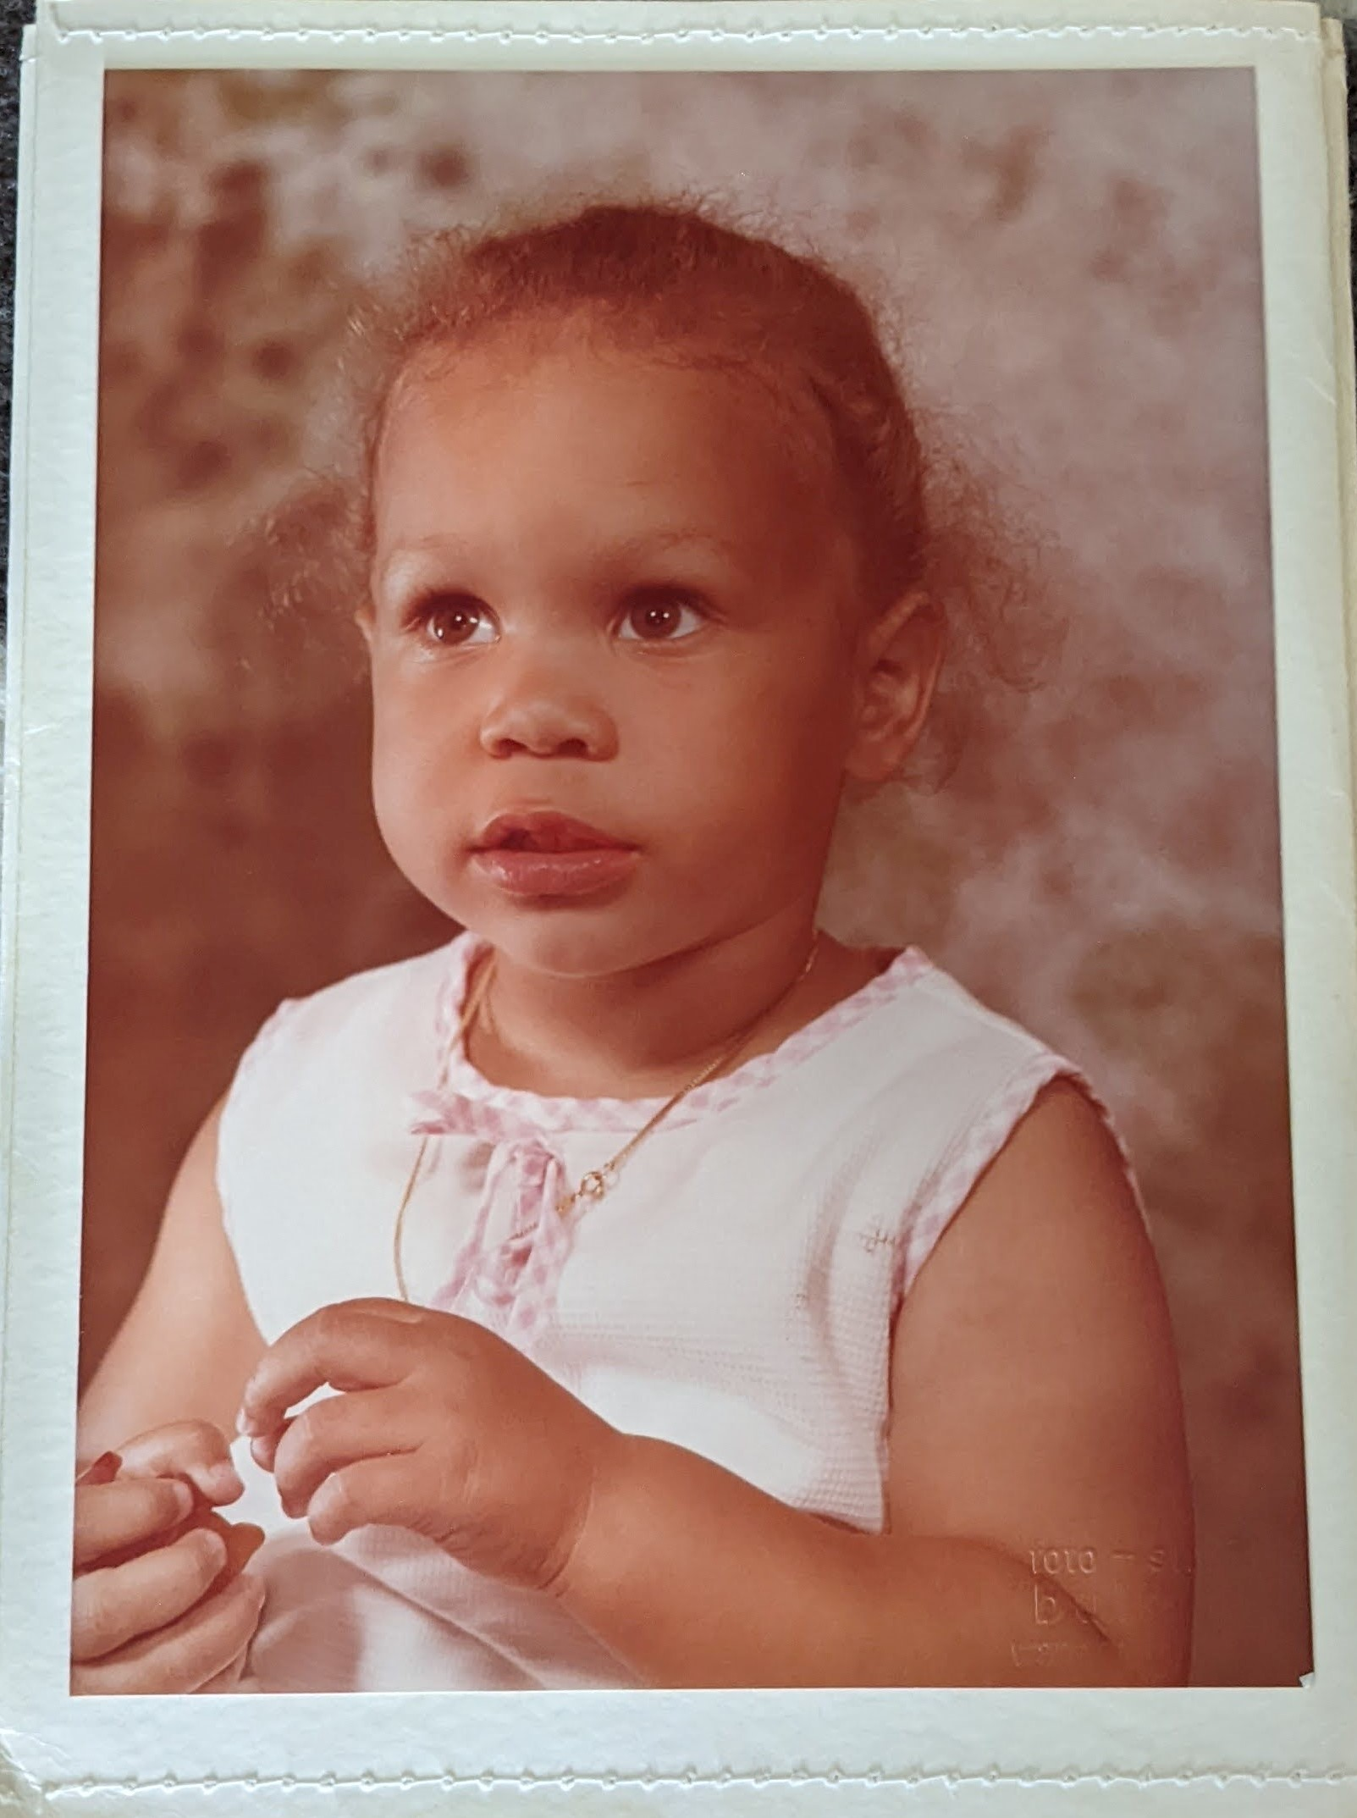
Hello! I’m Sonja Thomas.

Slide 4
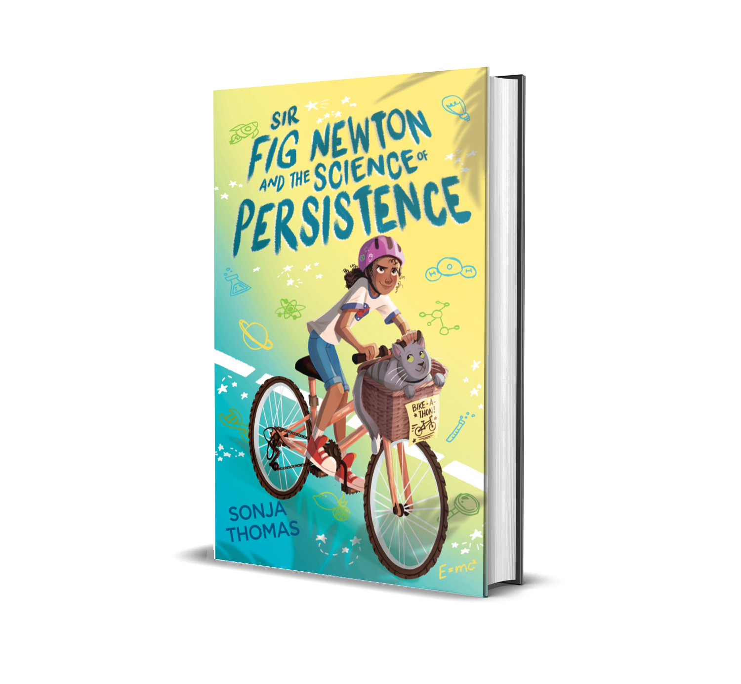
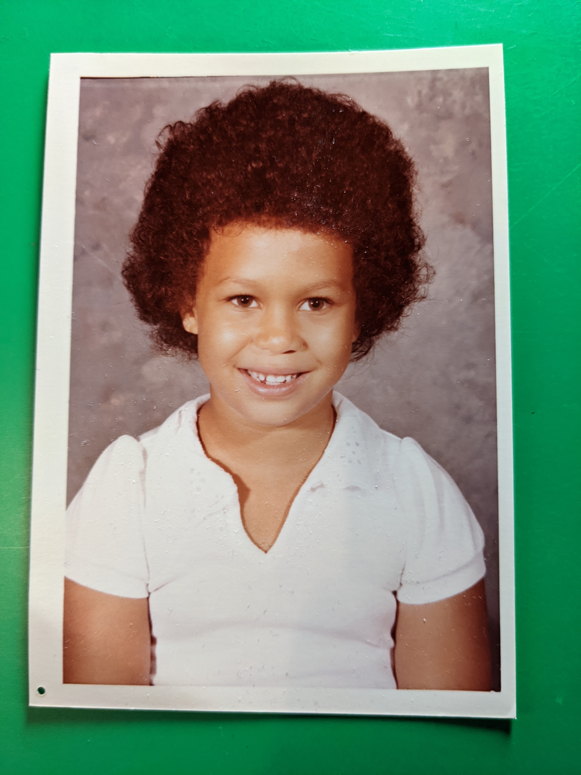
Hello! I’m Sonja Thomas.
"[Sonja] Thomas’ debut will pull at readers’ heartstrings.
A noteworthy debut.“
— Kirkus Reviews, starred review

Slide 5
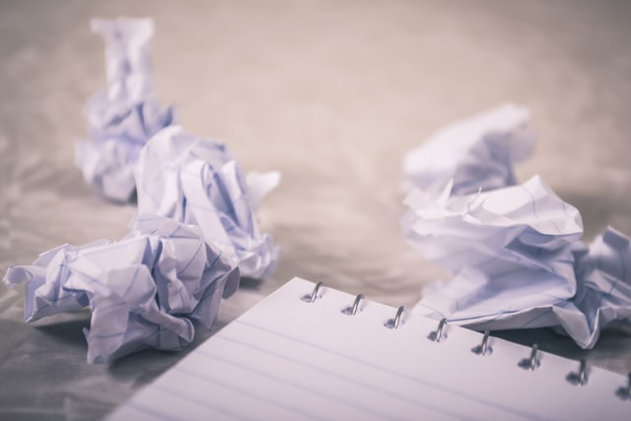
Writer’s Block

Slide 6
What is Writers Block?
Merriam-Webster: a psychological inhibition preventing a writer from proceeding with a piece.

Slide 7
What is Writers Block?
Dictionary.com: a usually temporary condition in which a writer finds it impossible to proceed with the writing of a novel, play, or other work

Slide 8
What is Writers Block?
Me: I wanna write, but I just can’t!

Slide 9
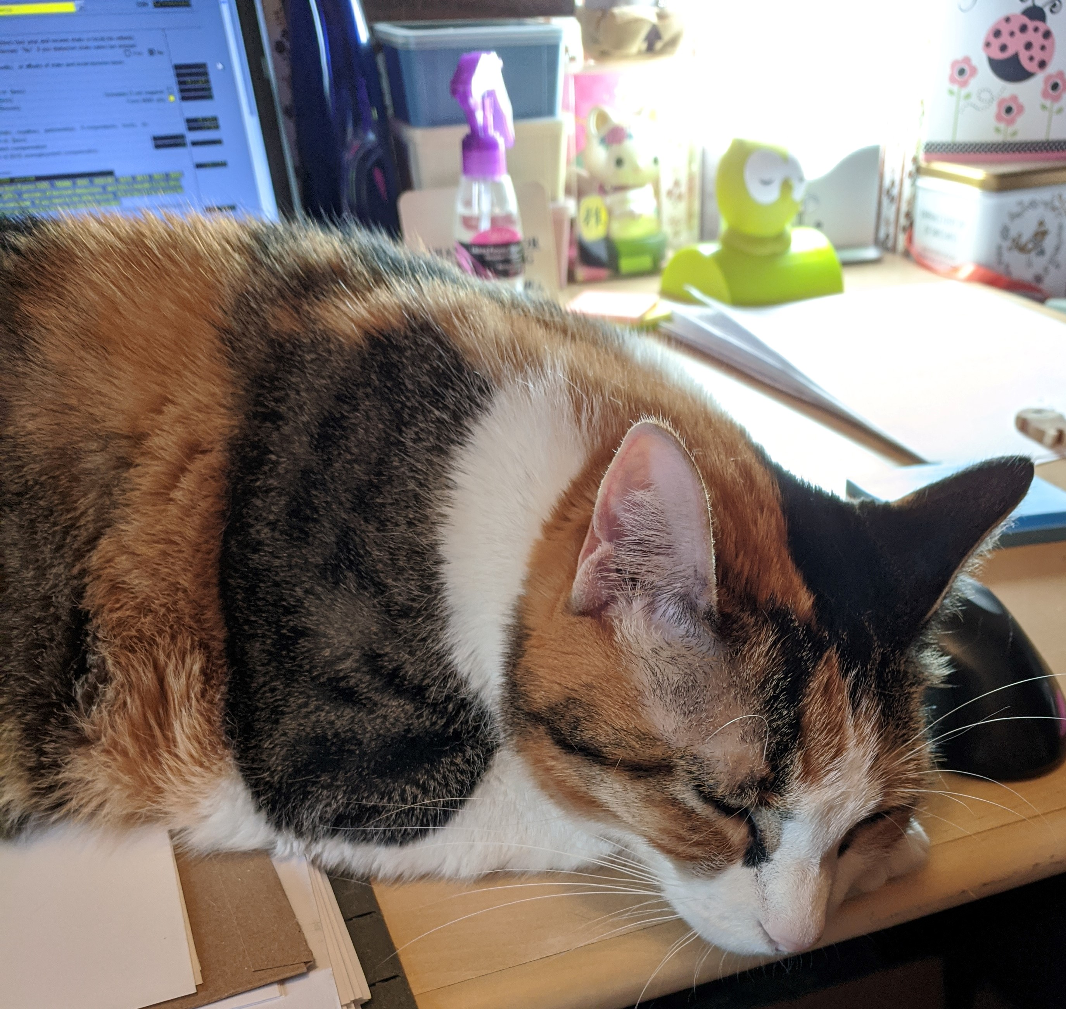
What Causes Writer’s Block
FEAR
WRONG TURN
BURN OUT

Slide 10
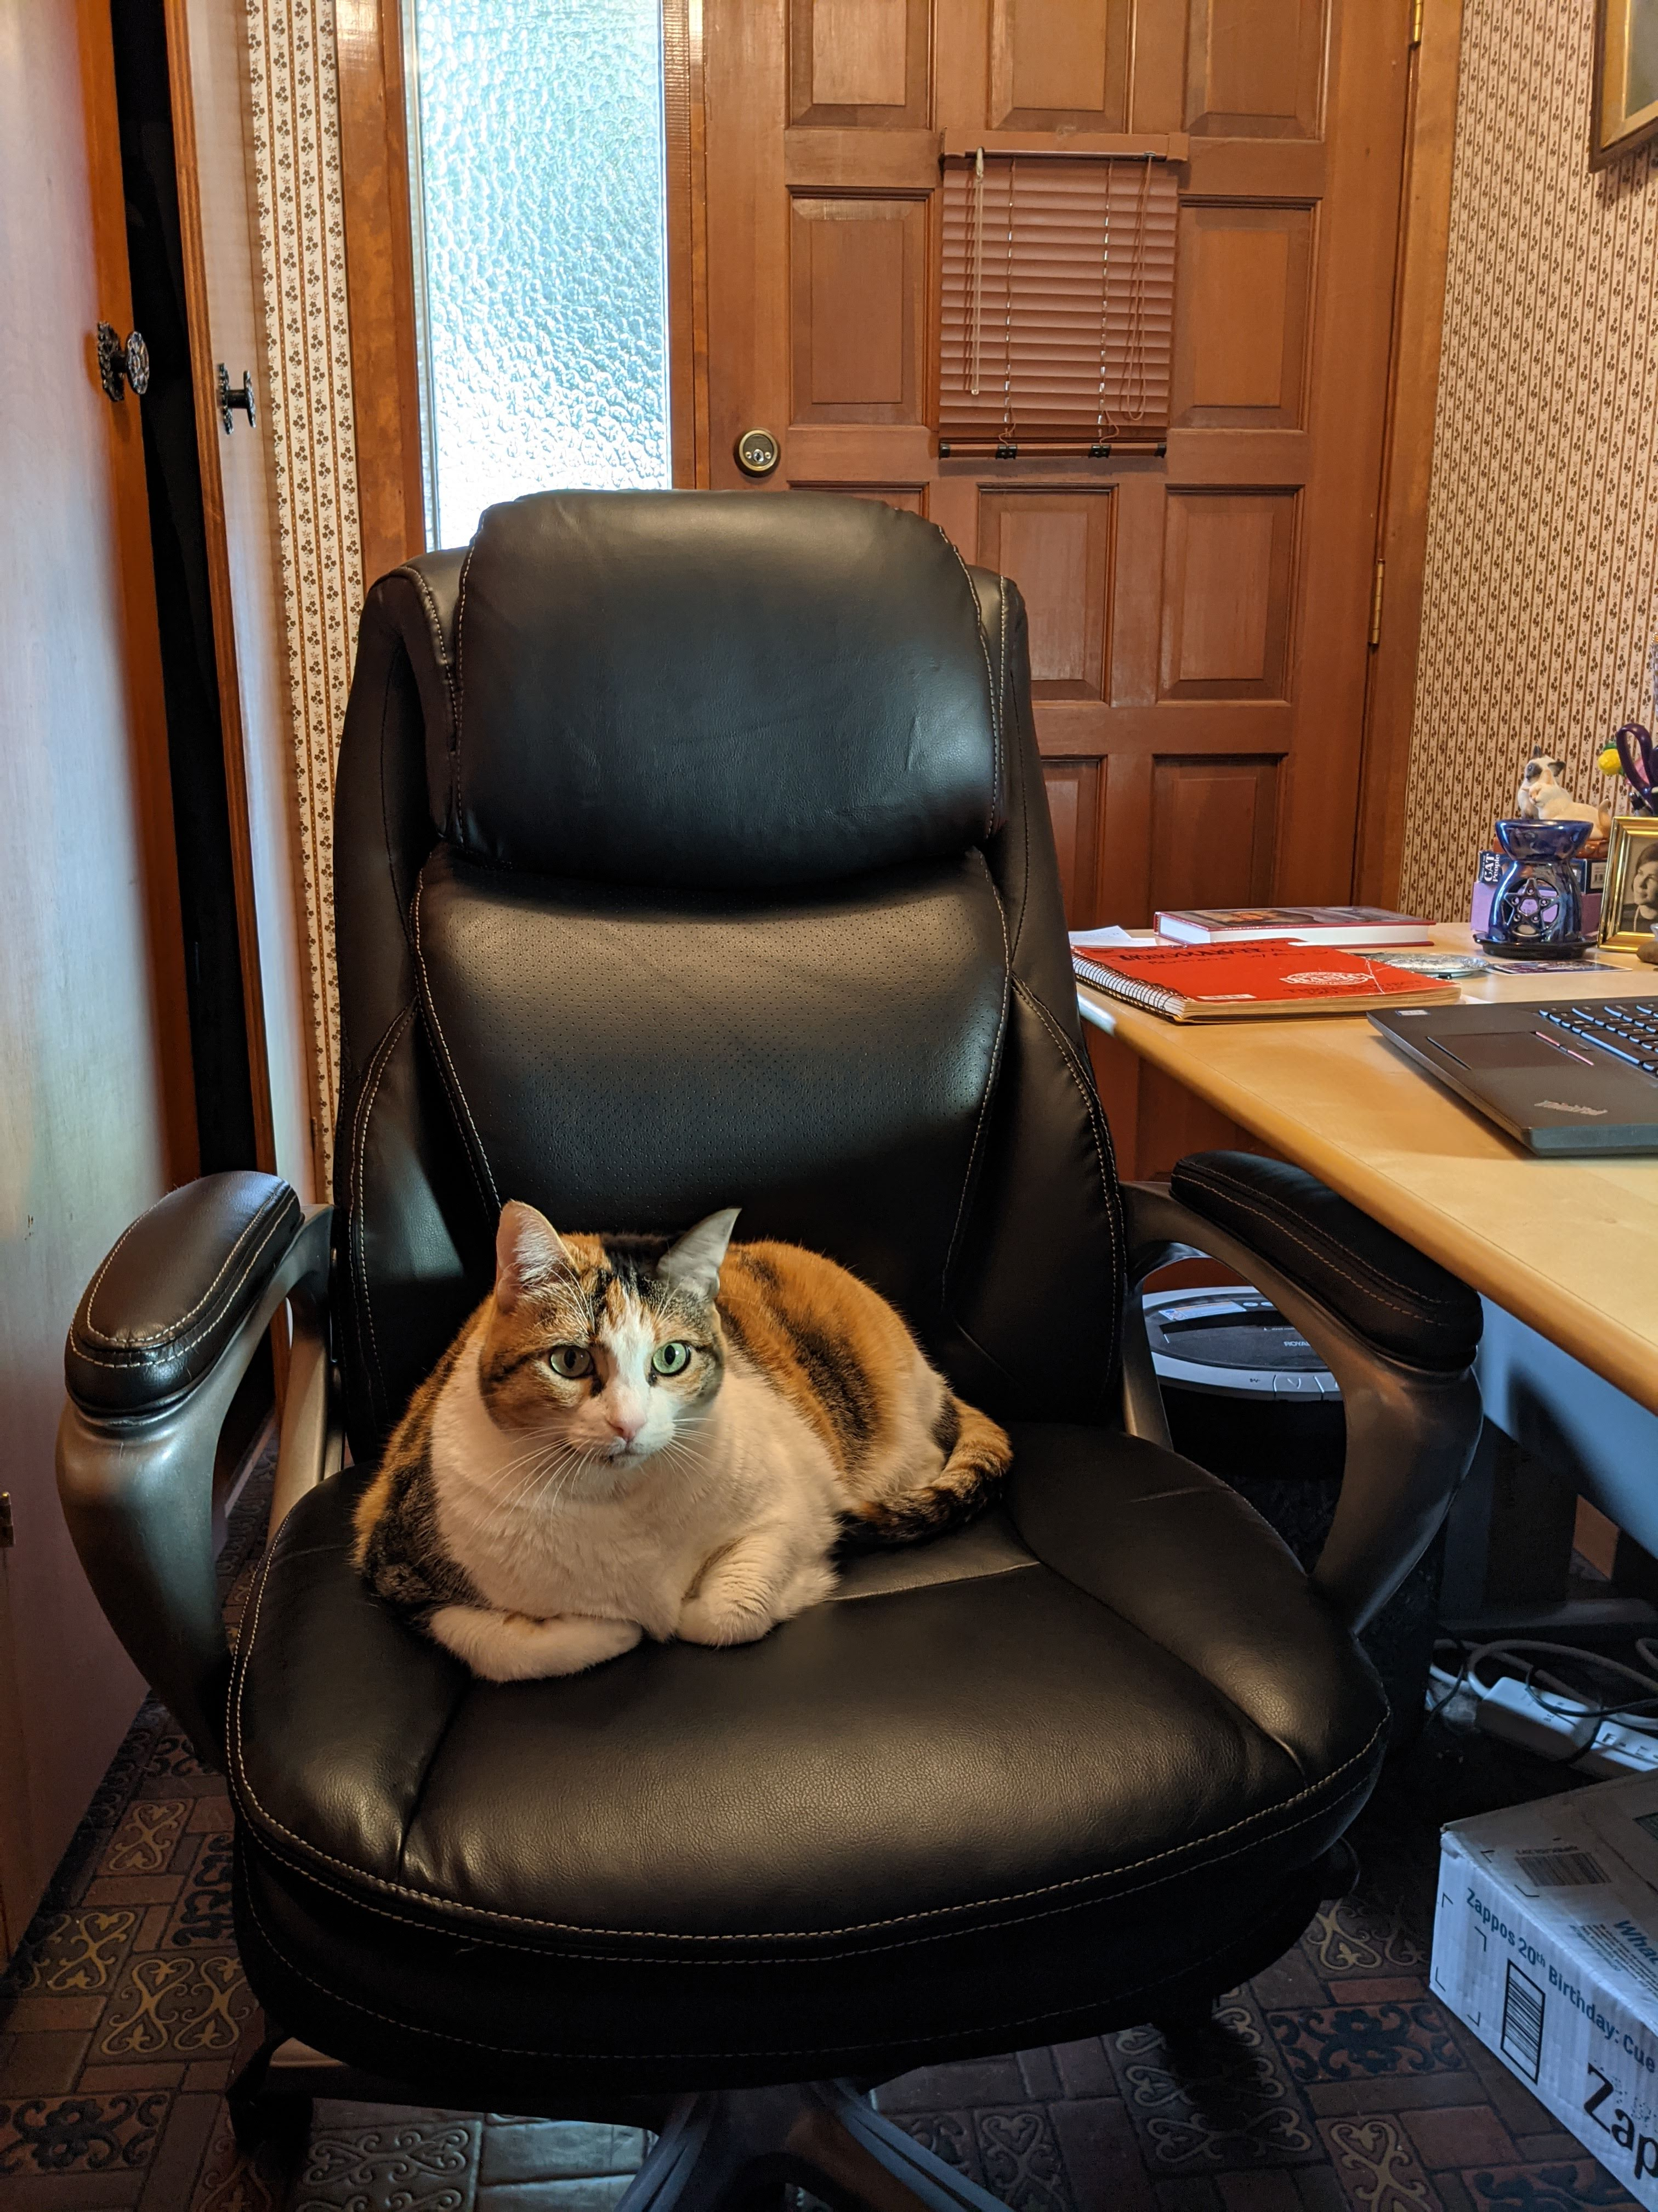
Fear
False belief: if I achieve my dream, then no more worries.
Fear will always be a factor, but you CAN move past it.
When you focus on the fear and start to believe it, it’s impossible to write.
What are your fears?

Slide 11
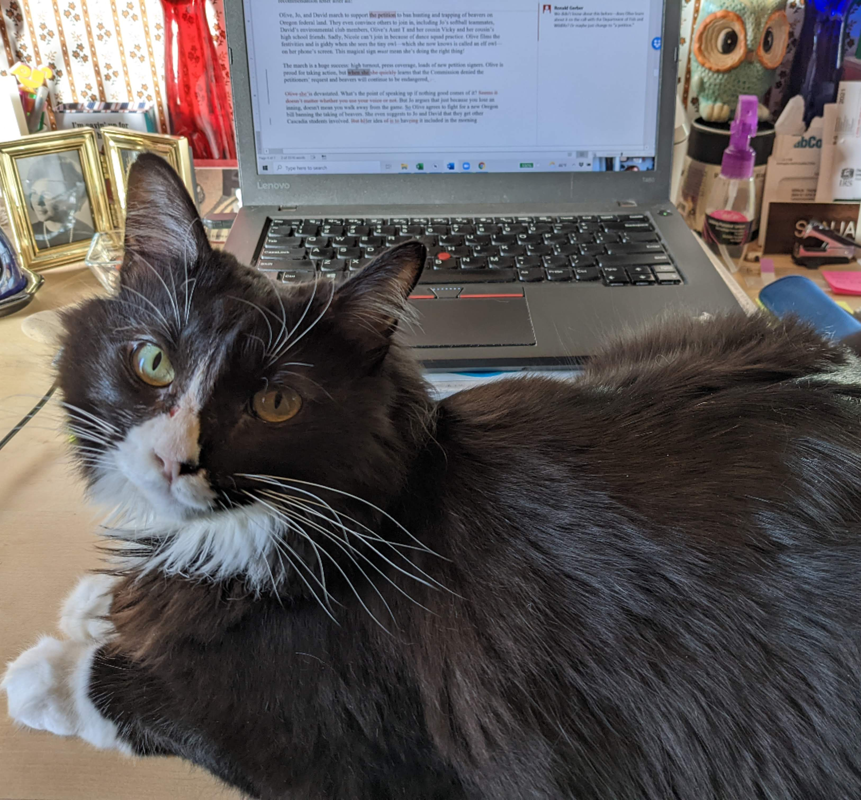
Diagnose Your Fear
Do I want to write?
What do I want to write?
What’s keeping me from writing?
What do I hope to accomplish when I’m done?
Am I attached to a specific outcome? A dream outside of my control?
What happens if I don’t reach my goal?

Slide 12
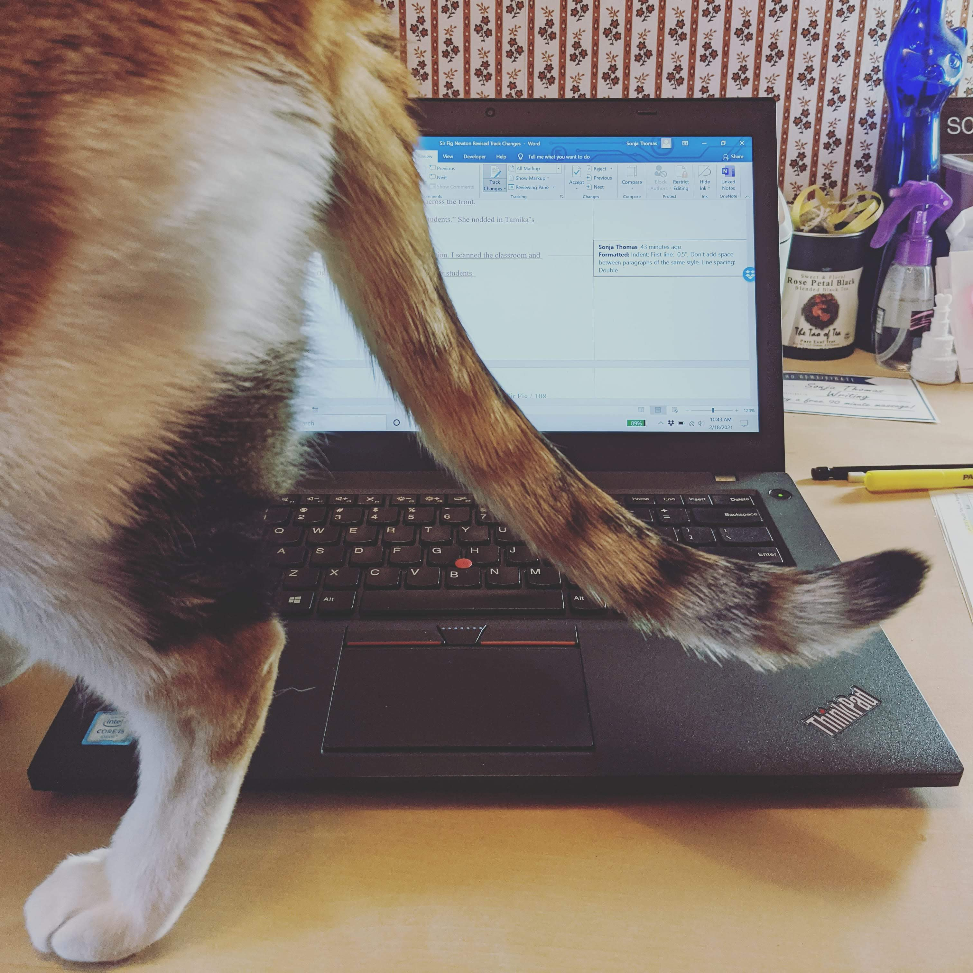
Move Past Fear
Refocus.
Rediscover.
Play!

Slide 13
Wrong Turn
Wrong Audience
Wrong Genre
Wrong POV / Tense
Wrong Direction
Wrong Story

Slide 14
Diagnose Your Wrong Turn
Do I want to write this story?
When did I stop having fun?
Is there a scene I just can’t move past?
Is there a feeling that something is wrong while writing this story?

Slide 15
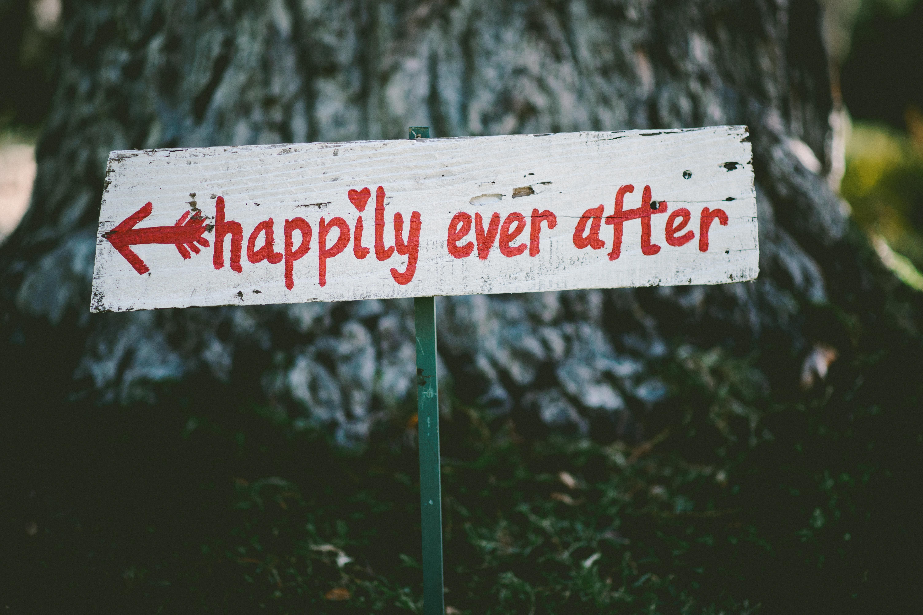
Move Past a Wrong Turn
Get out of your head
Talk it out
Brainstorm

Slide 16
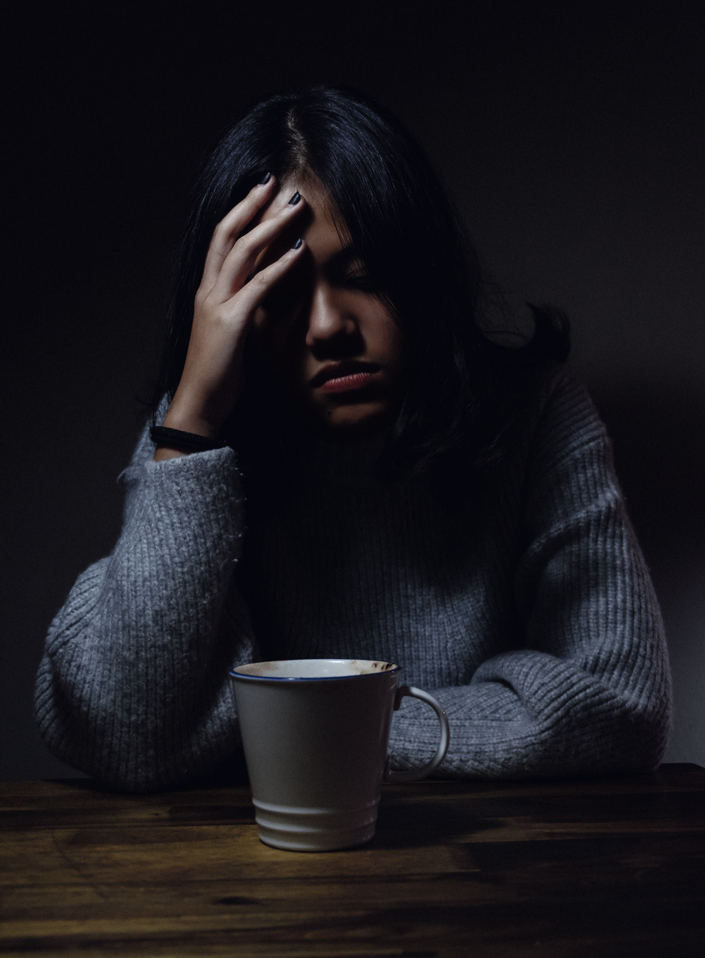
Burn Out
Sometimes You’re Just Tired
Low to No Motivation
Low to No Energy

Slide 17
Diagnose Your Burn Out
What’s going on in your life?
Trying to do too much?
Any extreme stressors?

Slide 18
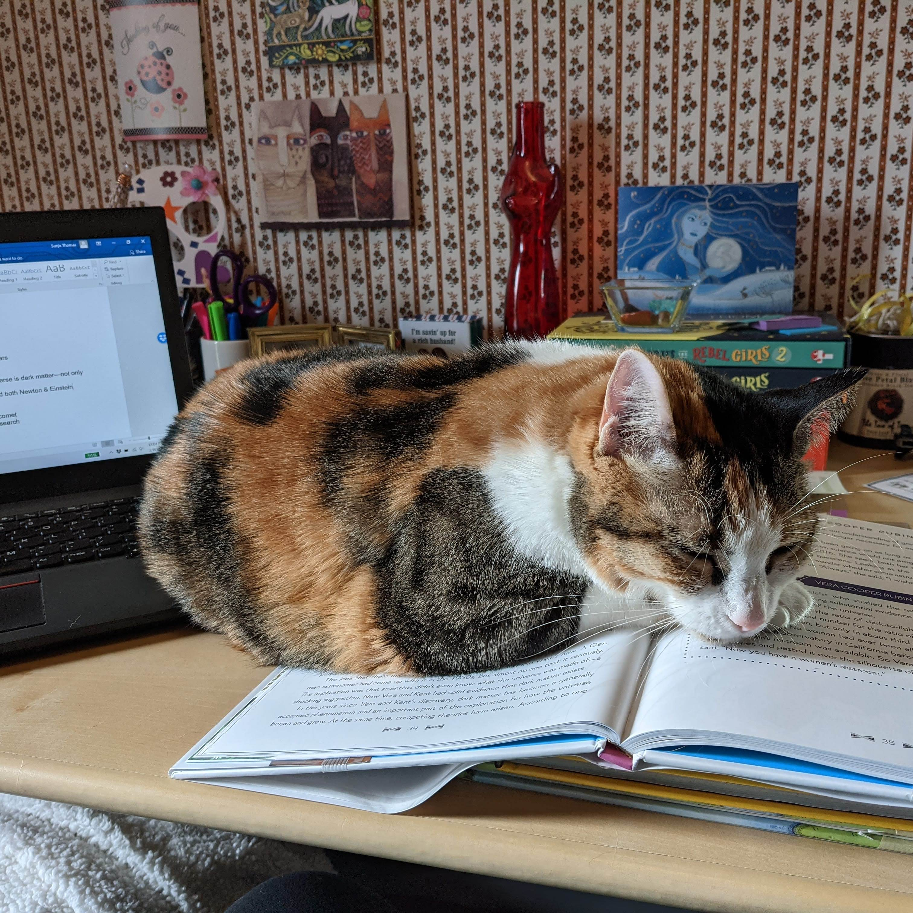
Move Past Burn Out
Rest
Refuel
Rejuvenate

Slide 19
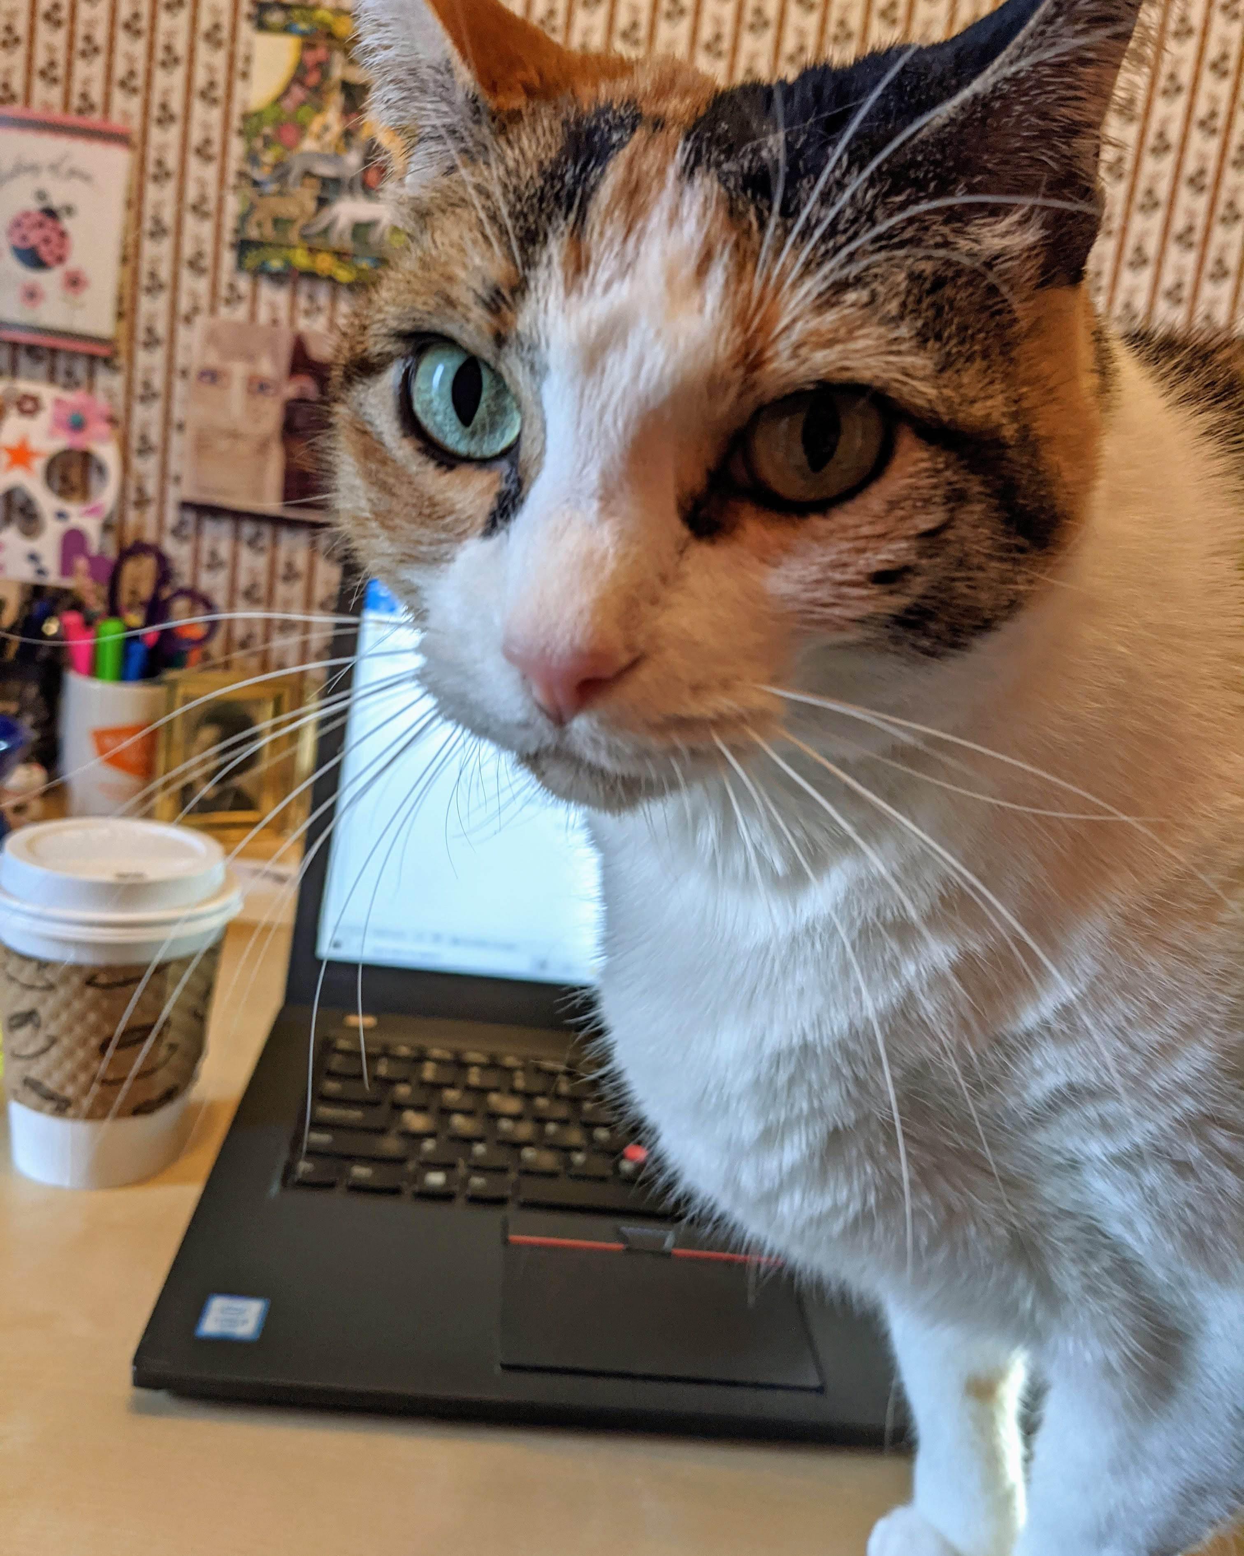
Additional Tools
Deadlines
Words Have Power
Celebrate!

Slide 20
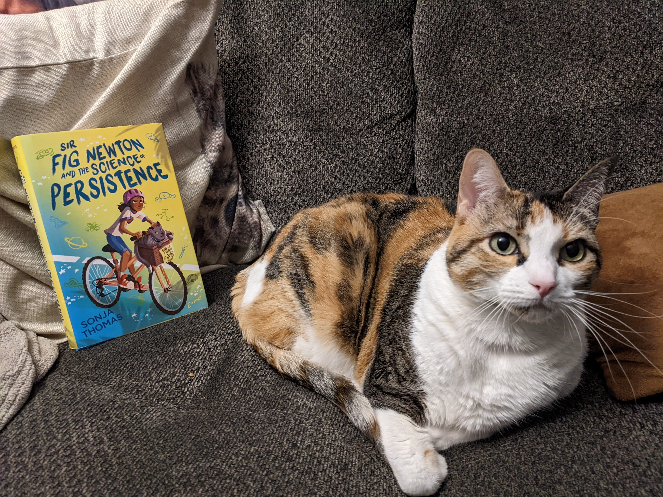
QUESTIONS?
Thank You!
Let’s Connect!
Website:
bysonjathomas.com
Instagram / Twitter: @bysonjathomas

