Slide 1
Roadmap to Research
By Jamie Bair and Elizabeth Moss

Slide 2
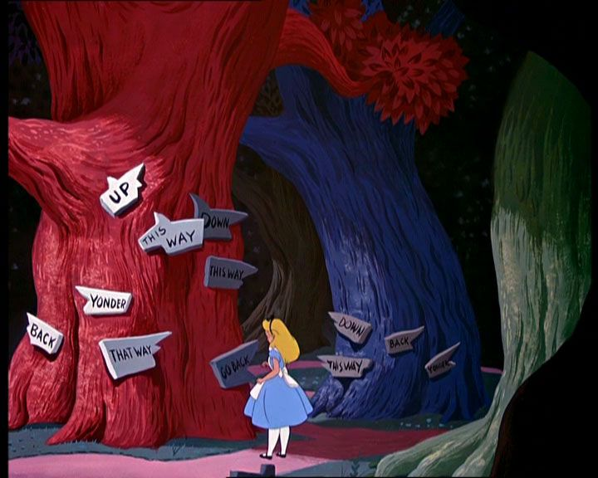

Slide 3
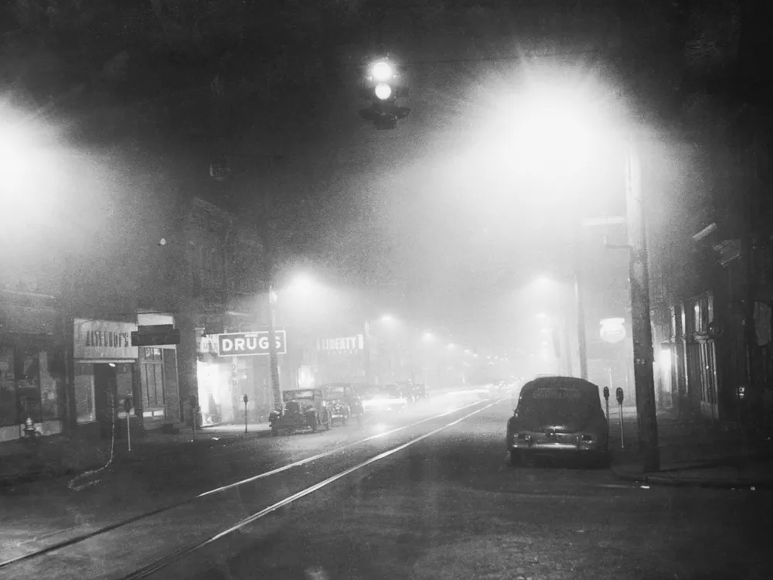
Donora of the Dead
Death in Donora
I have felt the fog in my throat --
The misty hand of Death caress my face;
I have wrestled with a frightful foe
Who strangled me with wisps of gray fog-lace.
Now in my eyes since I have died.
The bleak, bare hills rise in stupid might
With scars of its slavery imbedded deep;
And the people still live -- still live -- in the poisonous night.
Folklorist Dan G. Hoffman reported collecting the ballad "Death in Donora" from area resident John P. Clark
By Jamie and Elizabeth

Slide 4
An 85 year old man born in Pennsylvania is writing a memoir. His mother was born in Southwest Germany and immigrated to Pennsylvania in her youth. She met a man, they married and fell in love and had a boy (the protagonist). However, after World War II, there was a lot of anti-German sentiment and the family was often targeted by other members of the community. In 1948 when the boy was 10, his mother died during the Deadly Donora Smog of 1948.
The protagonist became an environmental engineer and is now retired. However, as he is researching his past for his memoir, he begins to suspect that his mother was murdered and someone in the town was using the Donora Smog to cover up the murder. As he reads his mother’s diary, he narrows in on the most likely culprit, their neighbor who, shortly after the smog incident, moved to Portland, Oregon. Can he discover the truth of his mother’s death? What will he find in Portland?

Slide 5
Write Your Outline and Group Research Topics
Historical
Cultural
Setting
Character
Plot

Slide 6
Culture
History
Plot
Setting
Character

Slide 7
What questions are you trying to answer?
Historical - Elizabeth
What was life like in Post-War America?
What was the Donora Smog about?
What else was happening in 1948?
Cultural - Jamie
What was someone from Southwest Germany like?
What was a recipe that a German immigrant would make when feeling homesick?
Setting - Elizabeth
What can I find out about Donora, PA?
What does Donora look like?
Character - Elizabeth
What could I find in the Oregon Genealogical Forum?
What information is available about my family’s history?
What is the job of an environmental scientist like?
Plot - Jamie
What poisons could mimic the symptoms of the Donora Smog illness?
What poisons were readily available in 1948?

Slide 8
FVRL Databases
Historical
Setting
Cultural
Character
Plot
Daily Life in History
Demographics Now
CultureGrams
Experience Passes
EBSCO Discovery Services
Religion and Philosophy (Gale OneFile)
Ancestry Library
Newspapers.com
Britannica Library Reference Center
Books
ILL
Trusted Library Resources
Issues and Controversies in History
Fire Insurance Maps Online
Ferguson’s Career Guidance Center
History Reference Center
Kanopy
Help! I’m Stuck!

Slide 9
Daily Life in History
Discover the everyday details about past eras that make historical accounts relevant and meaningful.
Things I learned:
Between 1945 and 1955, 15 million housing units were constructed in the US, leading to historic highs in home ownership.
5 years after the war, the amount spent on household furnishings increased 240%.
4 years after the war, 20 million refrigerators and 5.5 million stoves were bought.
Return

Slide 10
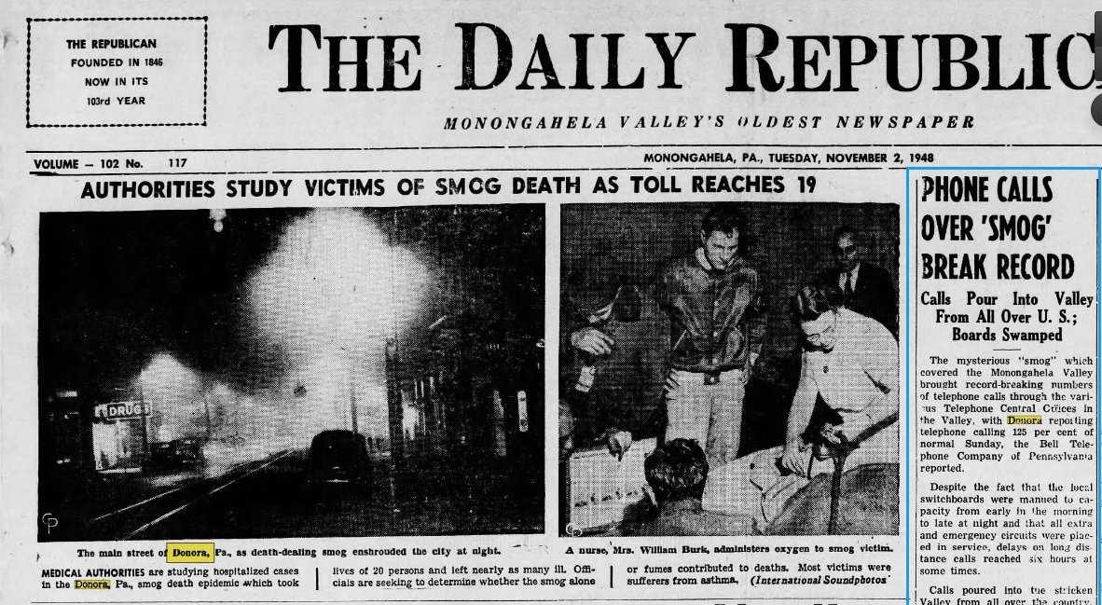
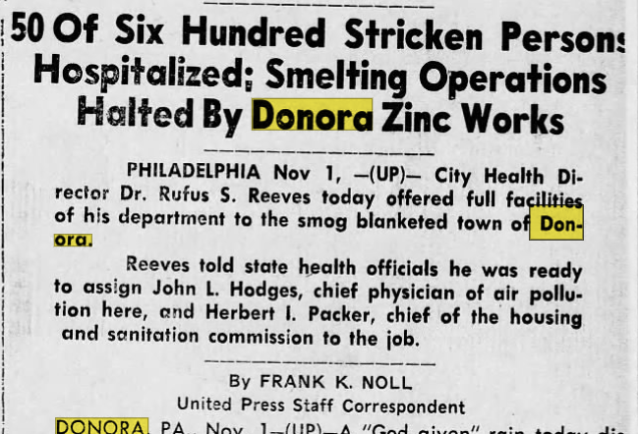
Newspapers.com
Search and browse the scanned pages of more than 4,000 historical newspapers dating from the early 1700s into the 2000s. Newspapers.com contains full runs and portions of well-known, regional, and state titles as well as small local newspapers in the U.S. and other countries.
Things I learned:
Return

Slide 11
Issues and Controversies in History
This comprehensive reference database has been expanded to cover every region of the world from antiquity to the present.
Things I learned:
The Issue
Background
Case For
Case Against
Conclusion
What If…
Bibliography
Return

Slide 12
History Reference Center
View full-text reference books, encyclopedias, non-fiction books, history periodicals, documents, and biographies along with historical photos, maps, and videos.
Things I learned:
Zinc workers received a full day's wages for an arduous four-hour shift, and men worked in pairs in case anyone succumbed like the wild birds which fell, mid-flight, to the mill's dusty floor.'" A company nurse routinely treated employees for "zinc jitters", and laborers "retired" by age 29." Zinc workers philosophically accepted the risks, but the unsuspecting public mistakenly considered itself safe.
Return

Slide 13
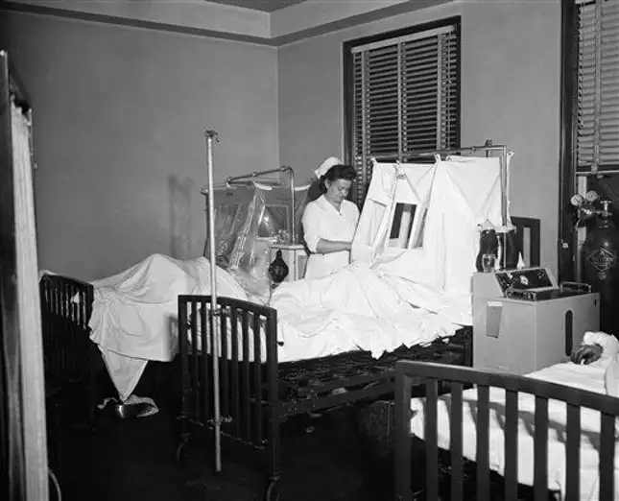
Kanopy
Stream independent films, documentaries, classic films, Great Courses, Milestone Films, world cinema, kids' educational programming, and kids' movies (with Common Sense Media ratings).
Things I learned:
Return

Slide 14
Demographics Now
Access a variety of ready-to-use and customizable demographic data reports for entrepreneurs, students or anyone who needs to identify cultural patterns or sociological trends.
Things I learned:
15.7% of housing units are vacant.
54.6% of residents never went to college.
22.1% of households have no vehicle.
Average household spends $48.24 on books per year.
Average household spends $394.71 on tobacco products per year.
Average household spends $7.57 on white bread and $74.59 on bread other than white per year.
Average household spends $78.45 on coffee per year and $37.35 on tea.
Return
Notes:
For comparison, Vancouver WA has:
5.6% of housing units are vacant.
34.6% of residents never went to college.
7.7% of households have no vehicle.
Average household spends $86.53 on books per year.
Average household spends $361.24 on tobacco products per year.
Average household spends $9.97 on white bread and $65.75 on bread other than white per year.
Average household spends $103.61 on coffee per year and $63.95 on tea.

Slide 15
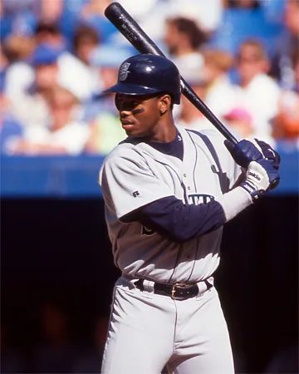
Britannica Library Reference Center
Search or browse articles, media, biographies, and a world atlas for information on both academic subjects and personal interests. Start with Research Tools and Materials if you're doing academic research.
Things I learned:
Return
Notes:
Ken Griffey, Jr.

Slide 16
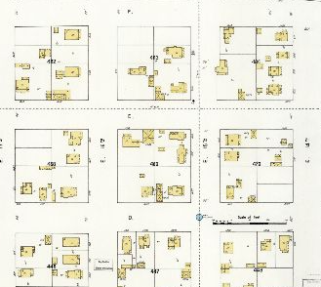
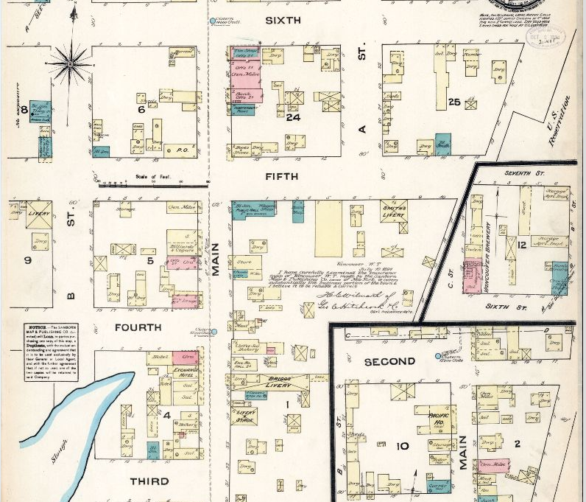
Fire Insurance Maps Online
Chart the growth and development of cities and towns in Washington with fire insurance maps (including Sanborn maps), plat books, real estate atlases, and other historical maps.
Things I learned:
Return
Notes:
Ken Griffey, Jr.

Slide 17
CultureGrams Online
Beware of Stereotyping and Tokenism!
Use CultureGrams to find maps and information on the peoples and cultures of over 185 countries, all 50 states in the U.S, and the provinces and territories of Canada. Includes a Kids Edition, too.
Things I learned:
Germans prefer their drinks without ice.
Germans tend to be industrious, honest, thrifty, and orderly.
They appreciate punctuality, privacy, intelligence and skill.
A typical German attitude is reflected in the phrases Das geht mich nichts an (That's not my business) or Ich will meine Ruhe (I want my peace of mind), both of which suggest an aloofness
A recipe for Berliner Krapfen (jelly doughnuts)
Return
Notes:
Ken Griffey, Jr.

Slide 18
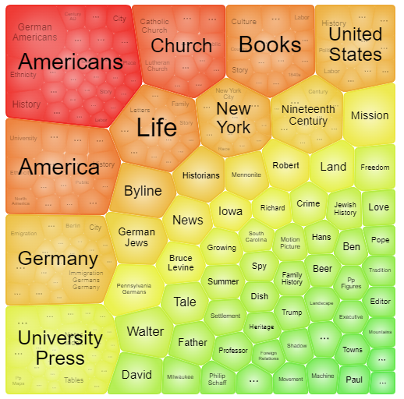
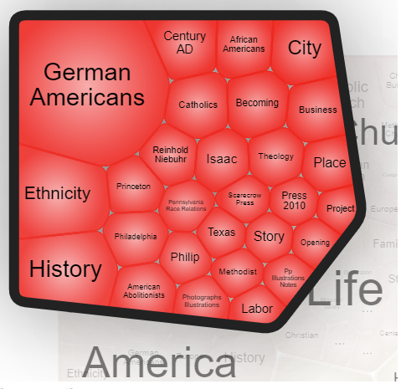
Religion and Philosophy (Gale OneFile)
Read articles on world religions, philosophies, and related fields.
Things I learned:
Topic finder for German Immigrant
Return
Notes:
Ken Griffey, Jr.

Slide 19
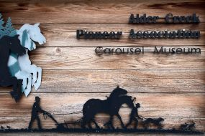
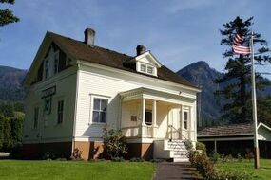
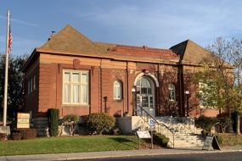
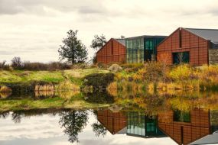
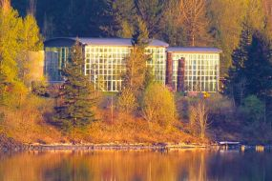
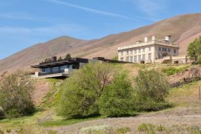
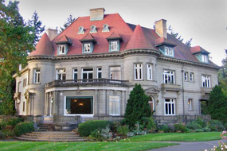
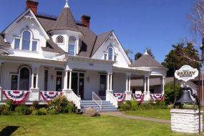
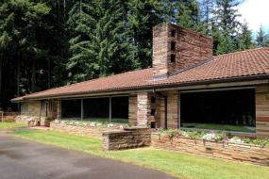
Experience Passes
Reserve free passes to local attractions with your FVRLibraries account!
Things I learned:
Return
Notes:
Ken Griffey, Jr.

Slide 20
Ancestry Library
Ancestry is available only at the library.
Learn about your ancestors. Search over 1.2 billion records in over 3,000 databases, including the U.S. Census and school yearbooks, to find records and digitized documents.
Things I learned:
I found 3 people who were born in Donora from 1905 - 1928 and who died in Portland between 1965 - 2006.
Return
Notes:
Ken Griffey, Jr.

Slide 21
InterLibrary Loan
Use ILLiad, FVRL's interlibrary loan system, to request material not available through the library catalog or FVRL's magazines and newspapers. Library staff will try to borrow the item you request from another library system and you'll get to use the item through your local branch!
Things I learned:
Return
Notes:
Ken Griffey, Jr.

Slide 22
Ferguson’s Career Guidance Center
Do a career interest assessment, research industries and careers, plan your education, get expert advice, and launch your career. Learn about 140 different industries and career fields and thousands of professions to find the one right for you.
Things I learned:
Environmental Engineers
Personality: Hands On, Realistic, Scientific, creativity, patience, the ability to "think outside the box," strong problem-solving and analytical skills, and a willingness to continue to learn
Skills: Interpersonal, Organizational, Scientific
Salary: $87,620
Minimum Education: Bachelor’s Degree
Were called civil engineers until 1970
Return
Notes:
Ken Griffey, Jr.

Slide 23
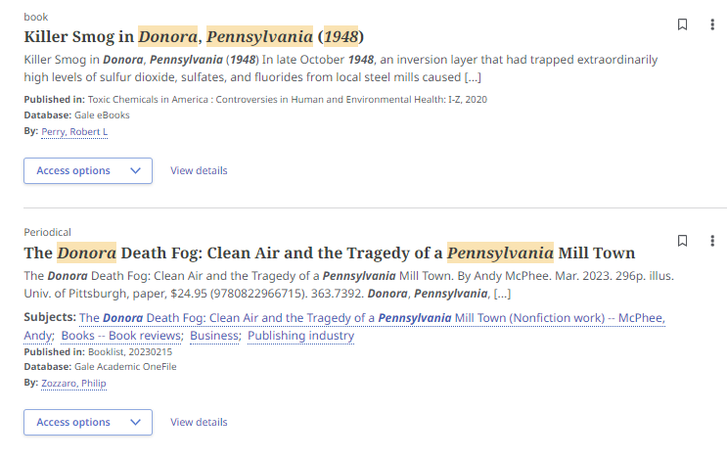
EBSCO Discovery Services
Don’t go down rabbit holes! Remember your outline and questions!
Find links to full-text articles without having to guess in which eResource to look! This search will look in most subscription eResources that contain journal, magazine, and newspaper articles, and serve up results no matter on which platform the article resides. No more trying one eResource after another in search of the article you need!
Things I learned:
Return
Notes:
Ken Griffey, Jr.

Slide 24
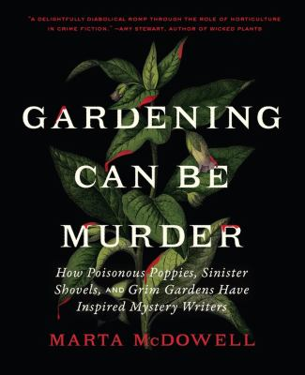
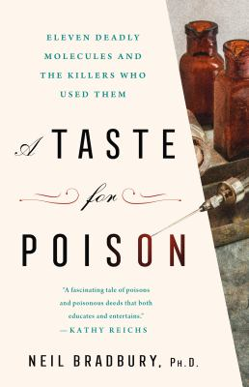
Books
The OG research tool!
Things I learned:
Return
Notes:
Ken Griffey, Jr.

Slide 25
Trusted Library Resources
When using the FVRL Resources by Topic, select a topic and scroll down to find web resources trusted by the library.
Topics with trusted library web resources:
Automotive & Electronics
Business
Computers & Technology
Consumer Information
DIY & Recreation
eBooks &eAudio
Employment & Careers
Genealogy
Geography & Culture
Government
Health
History
Images & Maps
Language Learning
Learning & Exam Preparation
Legal Information & Forms
Literature & Criticism
Magazines
Money
Newspapers
Nonprofit
Reading
Social Services
Taxes
Video
Return
Notes:
Ken Griffey, Jr.

Slide 26
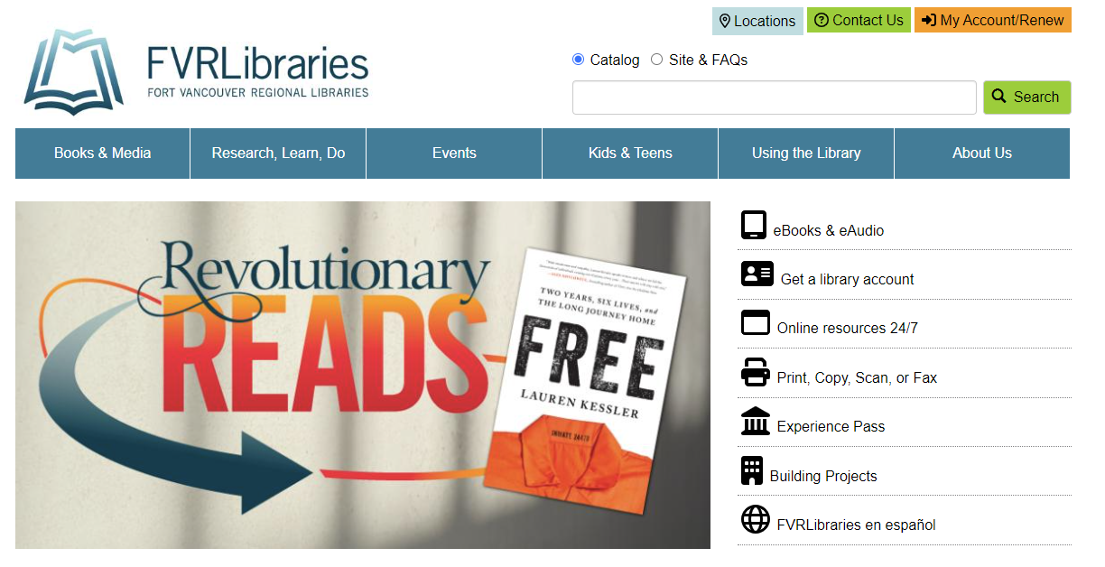
Ask a Librarian

Slide 27
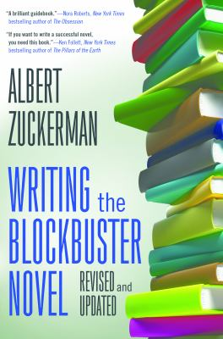
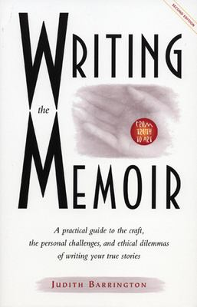
How to Write
Books
Online
Programs
LinkedIn Learning
Online Calendar

Slide 28
My book is published! Yay! What next?
How do I get the library to buy my book?
How do I donate my book to the library?
Can I reserve a meeting room to do a book reading/have a book launch?
What kind of library program options are available to increase awareness about my new book?

Slide 29
Thank you!
Any Questions?
Jamie Bair
Outreach & Programming Coordinator for Adults
jbair@fvrl.org
Elizabeth Moss
Three Creeks Community Library Branch Manager
emoss@fvrl.org

