Slide 1
2022-2023
Annual Report
Willamette
Writers
Willamettewriters.org
Community.
Craft.
Career.

Slide 2
Who we are
🞆As a non-profit educational organization, Willamette Writers is committed to helping writers connect with their communities, develop their craft, and expand their careers.

Slide 3
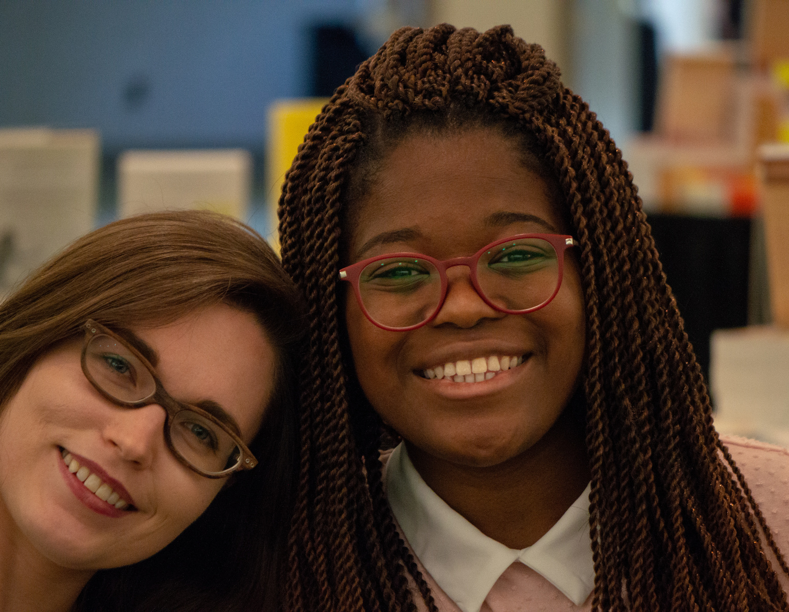
Members
Thank you for being a member of Willamette Writers! Your support makes our year-round programming possible.
1223

Slide 4
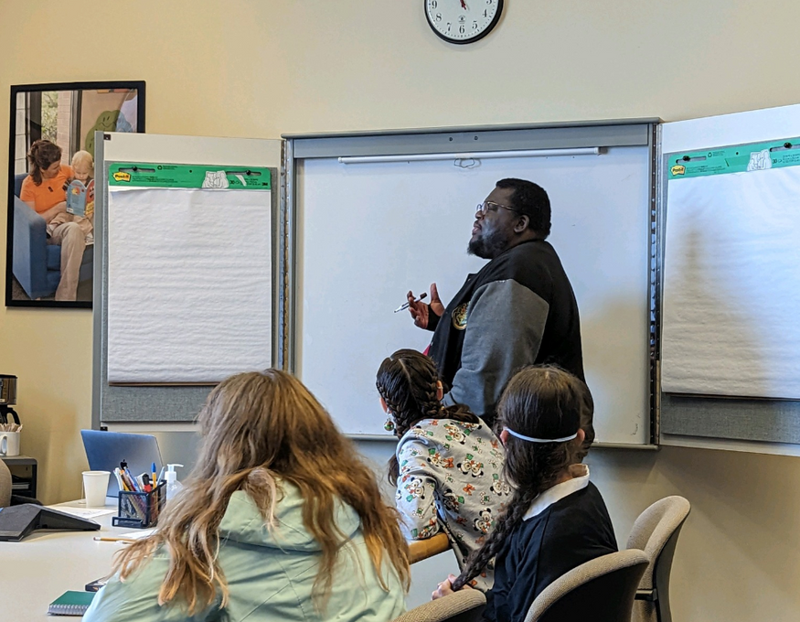
Chapter
Meetings
In-person chapter meetings are back!
We held twice as many chapter meetings this programming year.
91

Slide 5
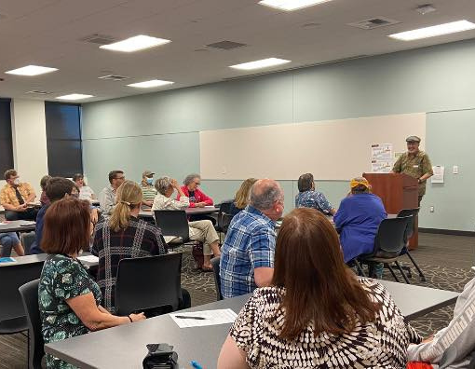
Hillsboro
Chapter
We kicked off our
Hillsboro Chapter with hybrid meetings at the Brookwood Library.

Slide 6
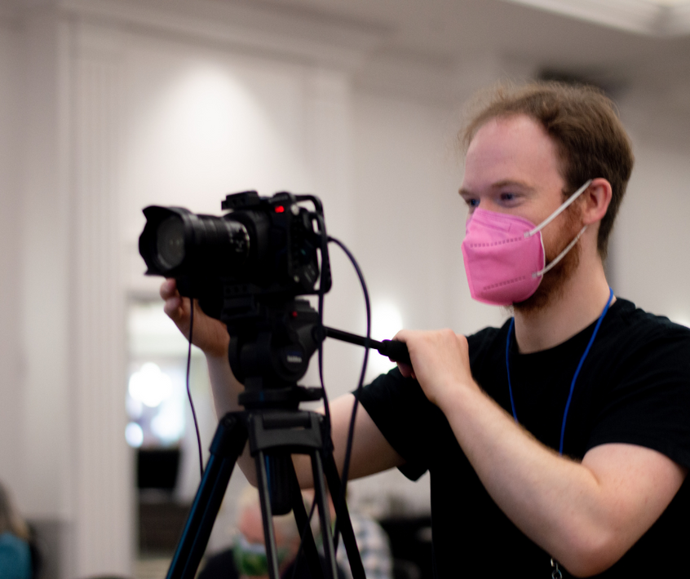
FilmLab
Chapter
Our FilmLab Screenwriter's Happy Hour now every month with presenters.

Slide 7
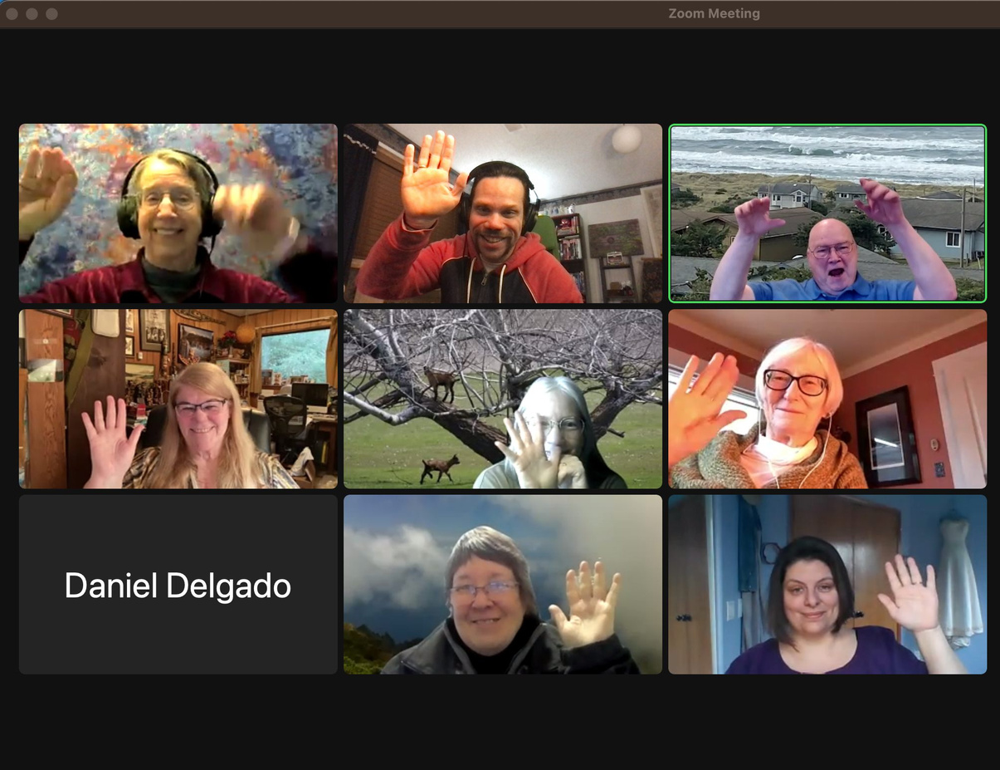
Networking & Productivity
Writers chatted over coffee this year, and they also and made plans and set goals in our online networking and productivity meetings.
138

Slide 8
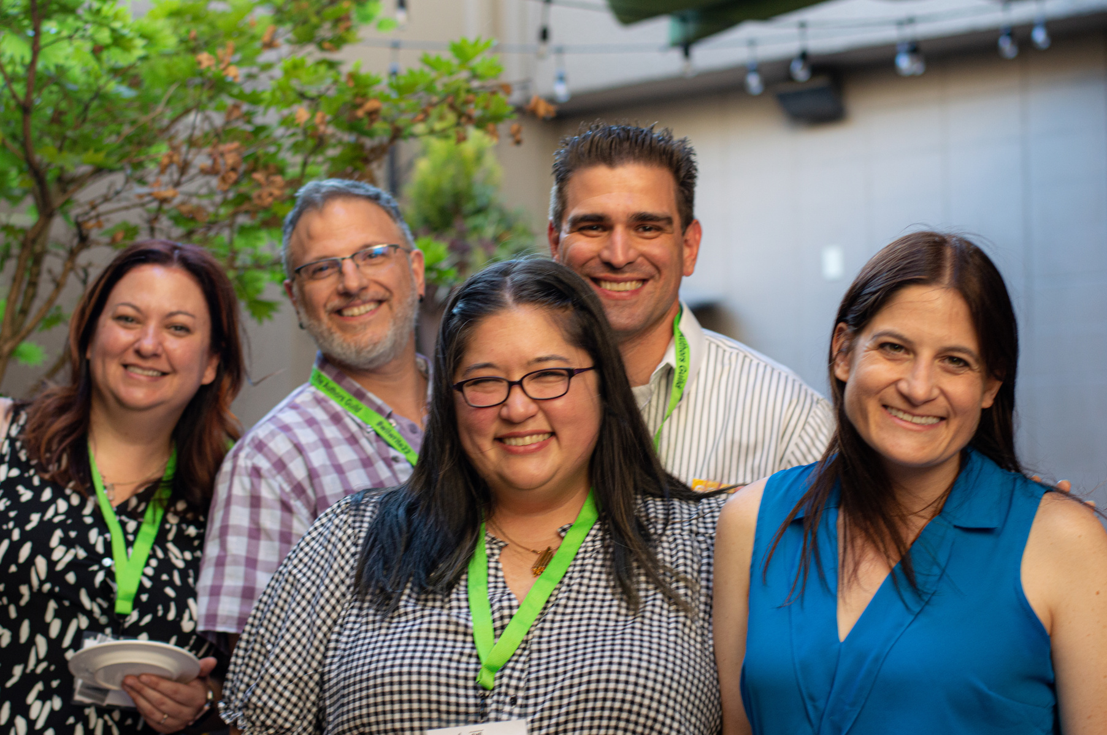
Online Critique Groups
Critique groups planning continued this year. Willamette Writers has helped 85 writers find a critique home since last June.
25

Slide 9
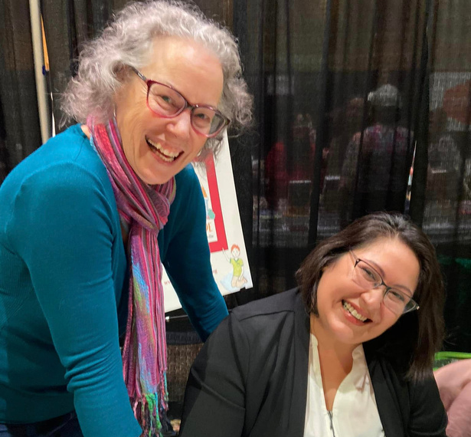
Program Participants
Total Participants
Unique Participants
6000+
1700+
Participants joined us both online and in-person

Slide 10
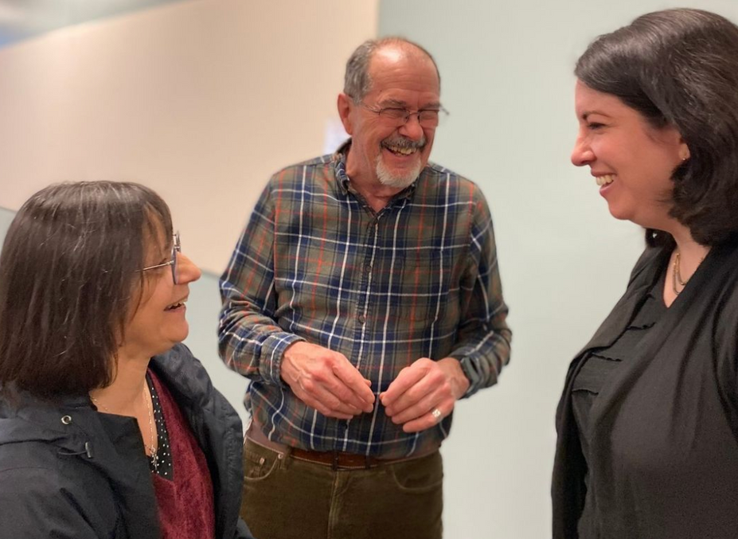
Year-round Volunteers
Absolutely none of this is possible without our 73 year-round volunteers. They do everything from accounting to social media. We are all WW!
73

Slide 11
2022-2023
Annual Report
In the Numbers
Willamettewriters.org
Community.
Craft.
Career.

Slide 12
Our strategic goal
Launch hybrid programming across Oregon and Southwest Washington and continue to decrease programming fees while ensuring a stable financial future for the organization.

Slide 13
The four-legged stool
Membership Dues
Programming Fees
Individual Donations & Sponsorships
Grants & Foundations

Slide 14
2021 2022
$100,000
Income
$75,000
$50,000
$25,000
$0
Member
Donate
Fees
Grants

Slide 15
Chapter Programming
Member Support
Conference Hotel & Programming
Utilities & Supplies
Office Staff
Accounting & Legal
Insurance
Website Hosting & Software

Slide 16
2021
2022
$200,000
Revenue and
Expenses
$150,000
$100,000
$50,000
$0
Revenue
Expenses

Slide 17
2022-2023
Annual Report
Board of Directors
Willamettewriters.org
Community.
Craft.
Career.

Slide 18
Our Board of Directors
Volunteer board
Professional board
Range of experience
Oversees the vision and the mission of the organization with an eye for financial and organizational stability

Slide 19
Election Process
The current board develops and approves the board slate.
The members are presented with the board slate.
Members vote on the board slate during the annual meeting.

Slide 20
Board of Directors Slate
Gail Pasternack
Kathleen Colvin
Jodie Fish
Bobbie Calhoun
Kathy Saviers
Curtis C. Chen
Jalyn Gilmore

Slide 21
Thank You
So Much!

